Slide 1
ACE Your Hearing
Core Module 1: Introduction and preparation

Slide 2

Video: Introduction to ACE Your Hearing

Slide 3
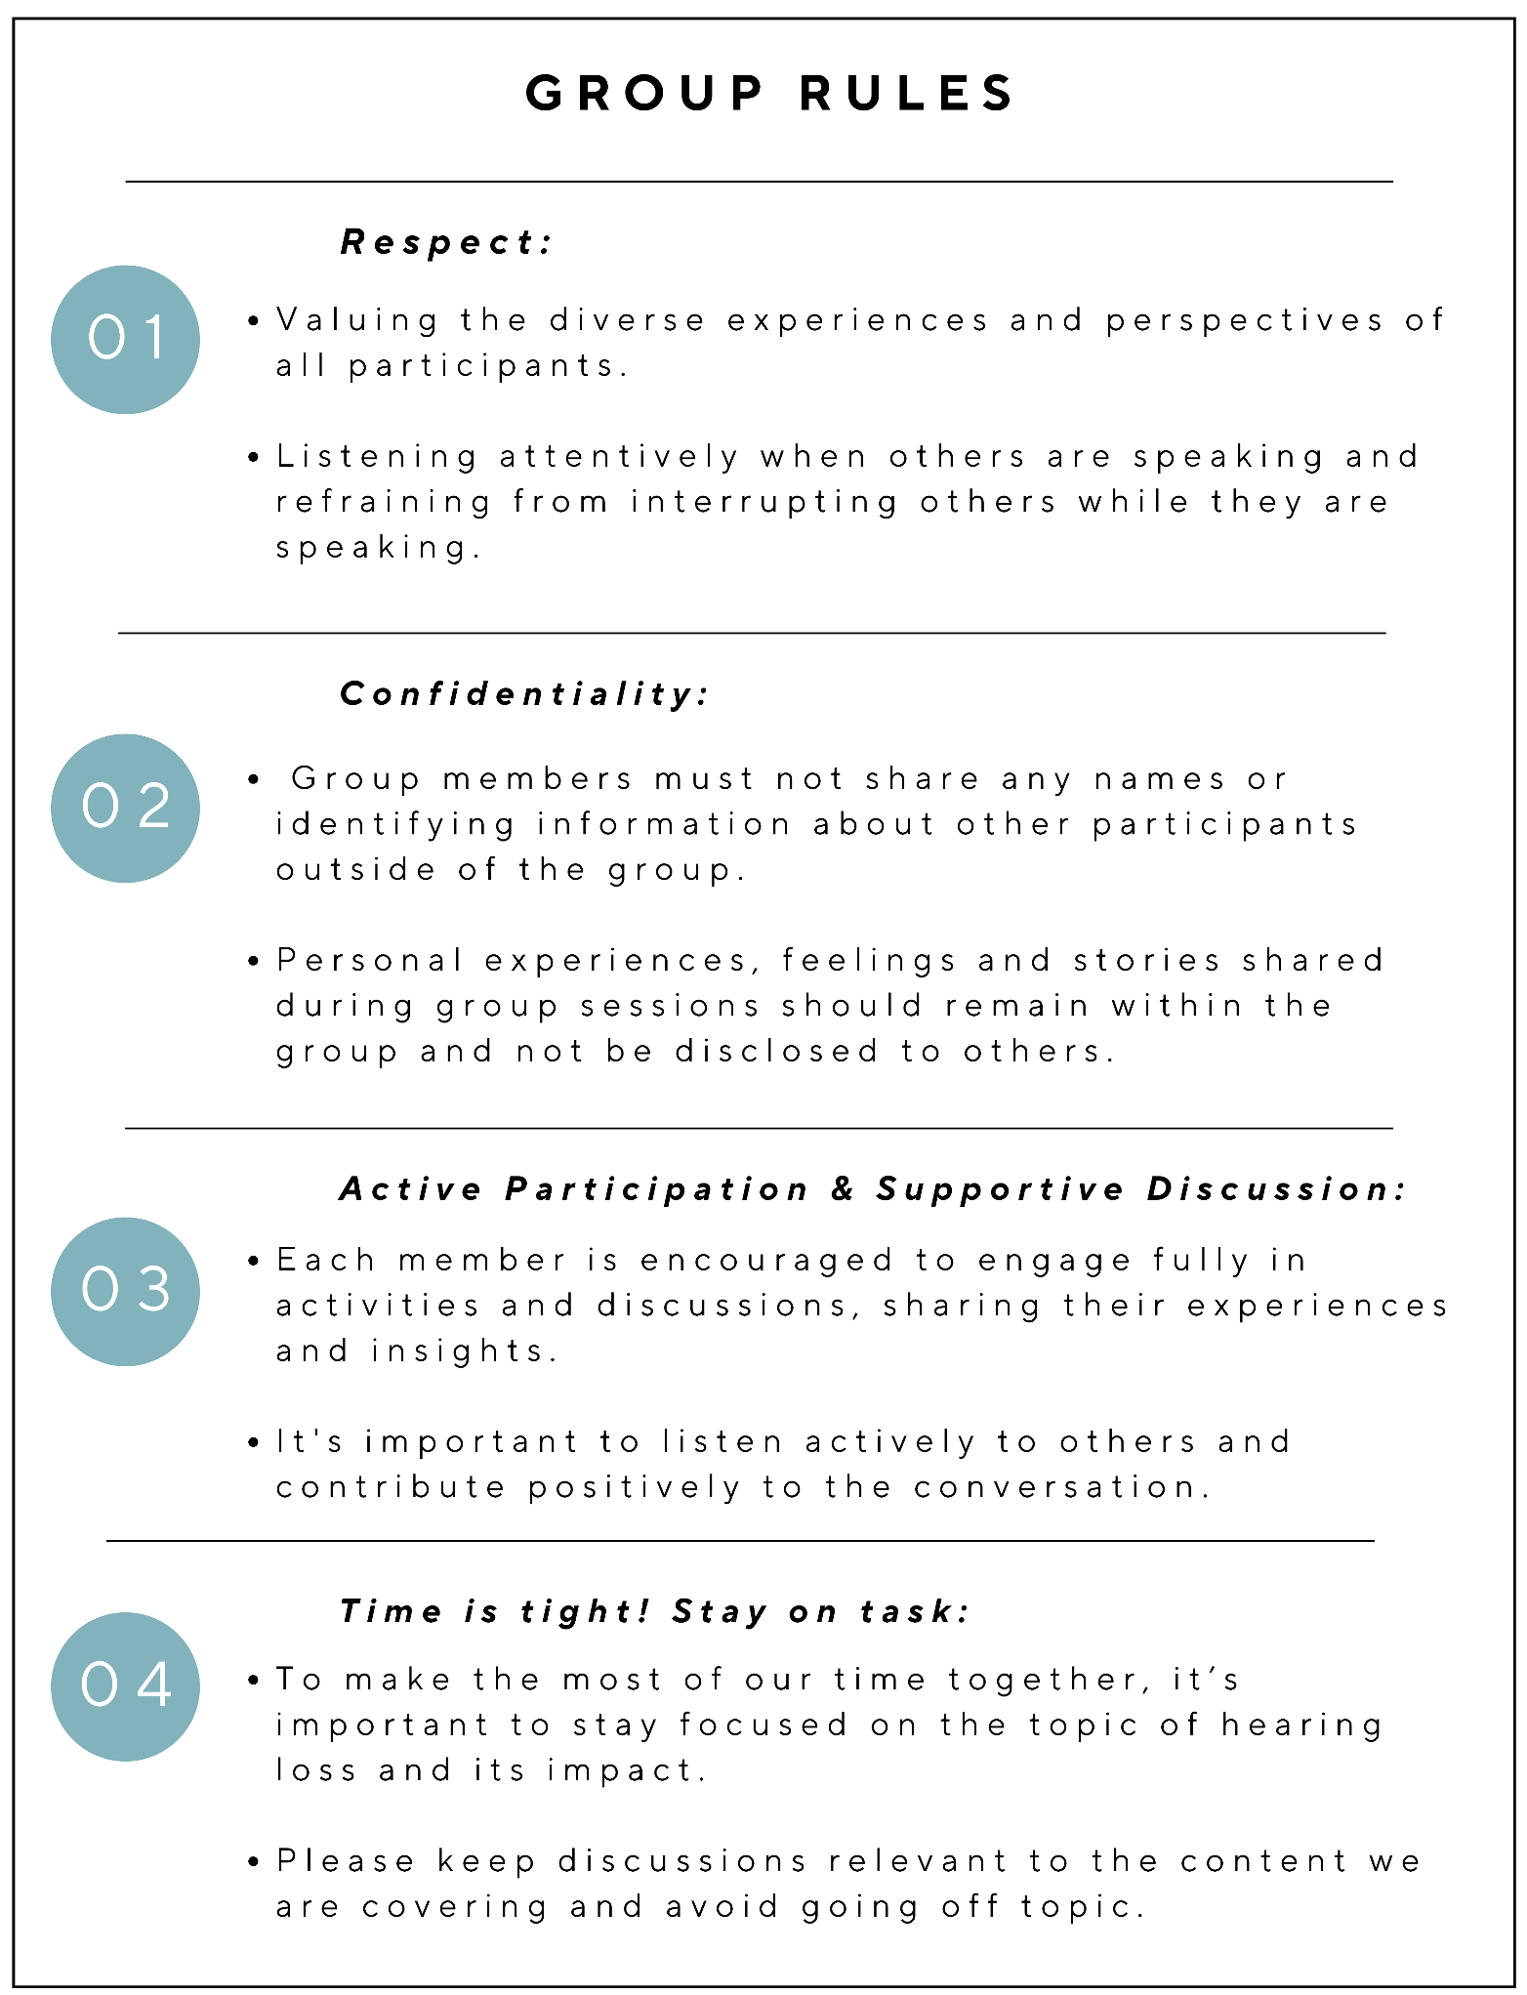
Group Rules:
To ensure all group participants have an enjoyable experience, we ask that you adhere to the following group rules.
Respect
Confidentiality
Active Participation & Supportive Discussion
Time is tight! Stay on task
Page 9 of workbooks
Notes:
Before we get started on this module, I would like to quickly recap our group rules. So remember, we always respect our other group members experiences and perspectives, we maintain confidentiality and don’t share personal information outside the group, we participate and share and support each other in the discussions, and we must remember to keep our focus on hearing loss and not get lost going down tangents or sharing experiences that are not related to the content we need to cover.

Slide 4
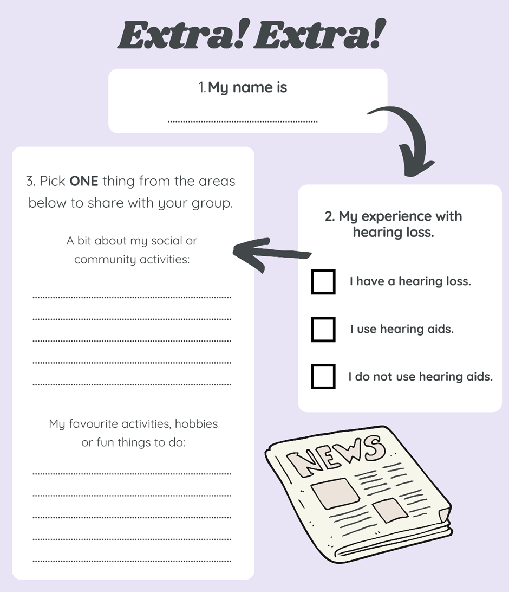
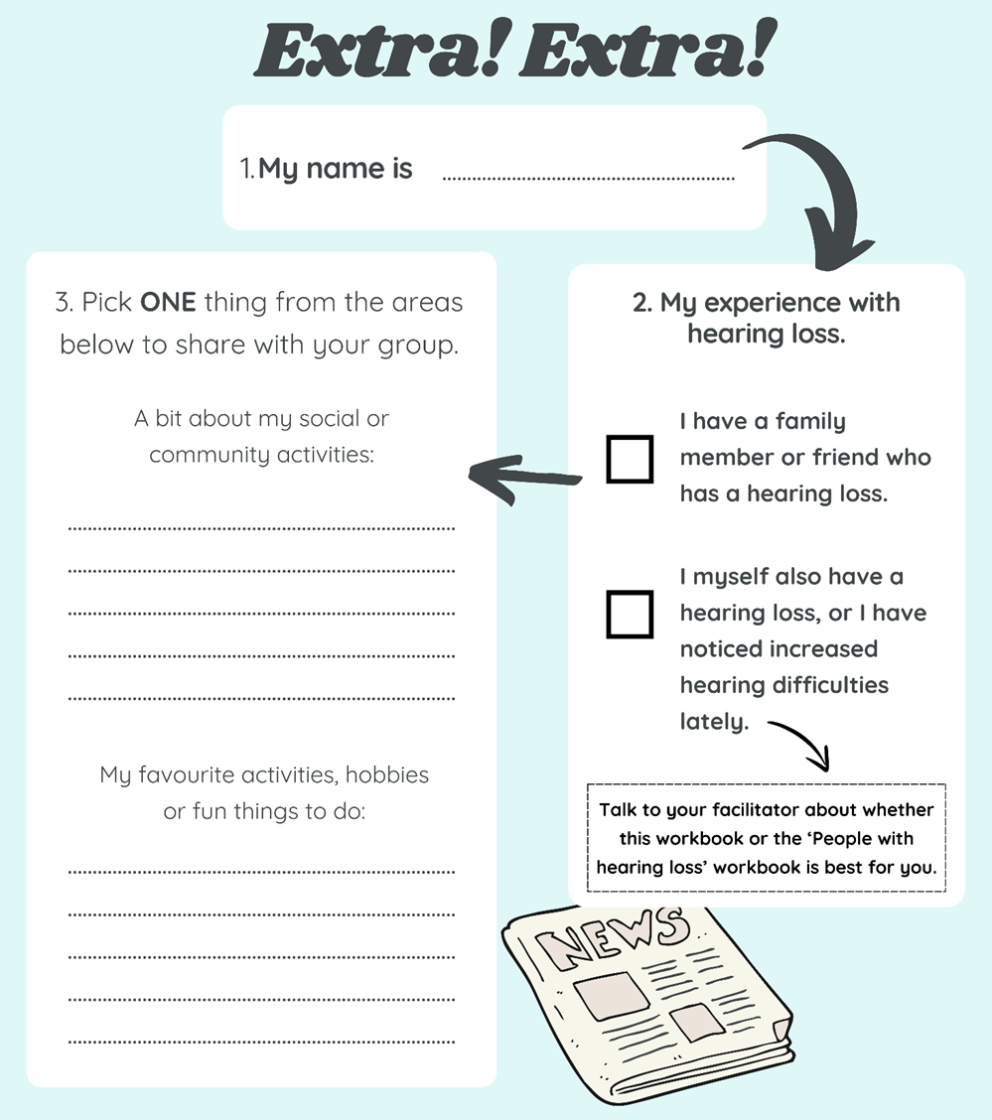
Group introductions:
Facilitator introduction
Group member introductions
- Take a minute to complete the Extra! Extra! Activity on page 10 of workbooks
- Go around the group and briefly allow all participants to introduce themselves.
- Time is tight! Keep introductions brief!
Page 10 of workbooks

Slide 5
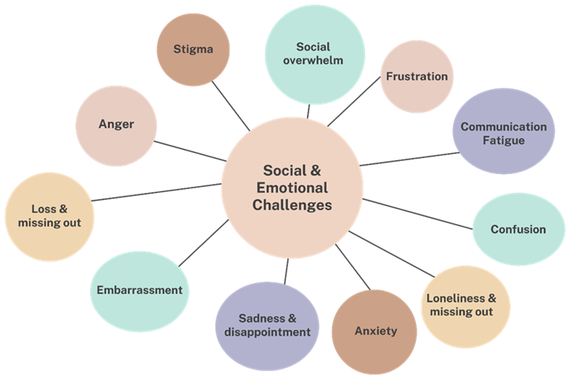
How does hearing loss affect communication, and social and emotional wellbeing?
Hearing loss can:
Make communication hard.
Impact how we connect with others.
Impact the emotional and social wellbeing of people with hearing loss and their family/friends.
Turn everyday conversations and interactions into a challenge
Increase misunderstandings and frustration when communicating.
Cause social withdrawal and a sense of isolation.
Here are some of the challenging feelings linked with hearing loss
Page 11 of workbooks

Slide 6

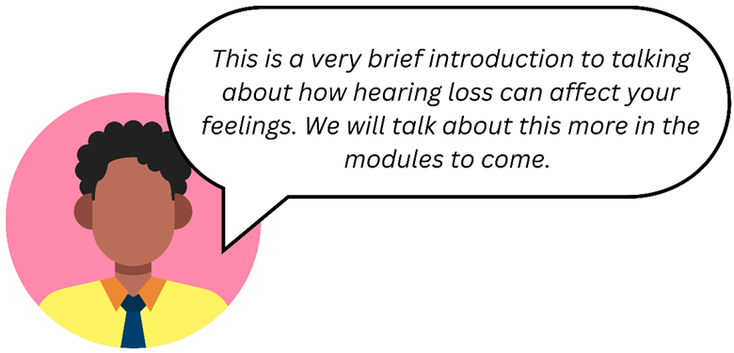
Activity: My feelings of hearing loss
Which of these feelings, or other challenges, do you feel you have experienced because of your hearing loss?
These feelings not only affect the person with hearing loss, but also the people around them. Do you think your family and friends have experienced any of these feelings, or other challenges, because of your hearing loss too?
Page 12 of workbooks

Slide 7
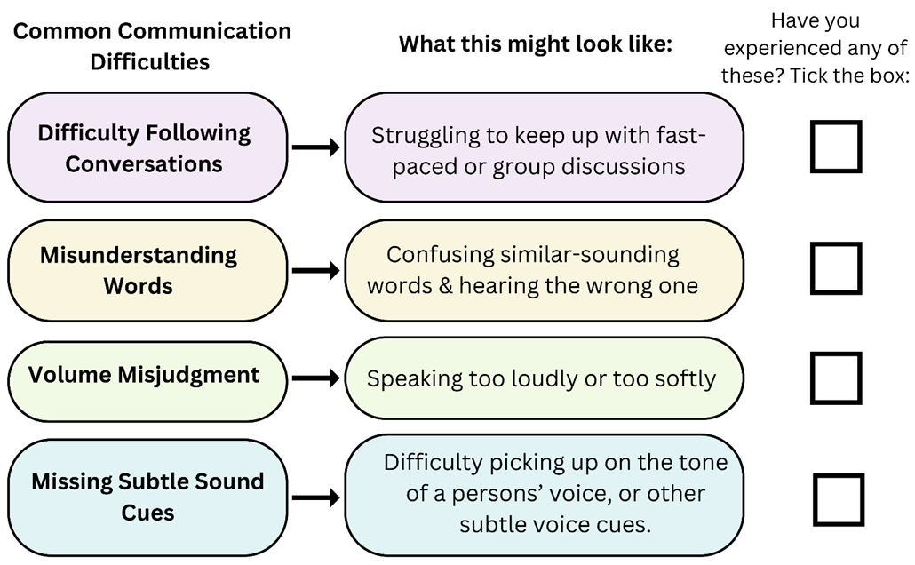
Activity: My communication difficulties
What do we mean by ‘communication’?
The words we use when we talk or write.
The way our voice sounds when we say something.
Listening carefully and responding.
Using body language like hand waves, head nods, and facial expressions.
Page 13 of workbooks

Slide 8
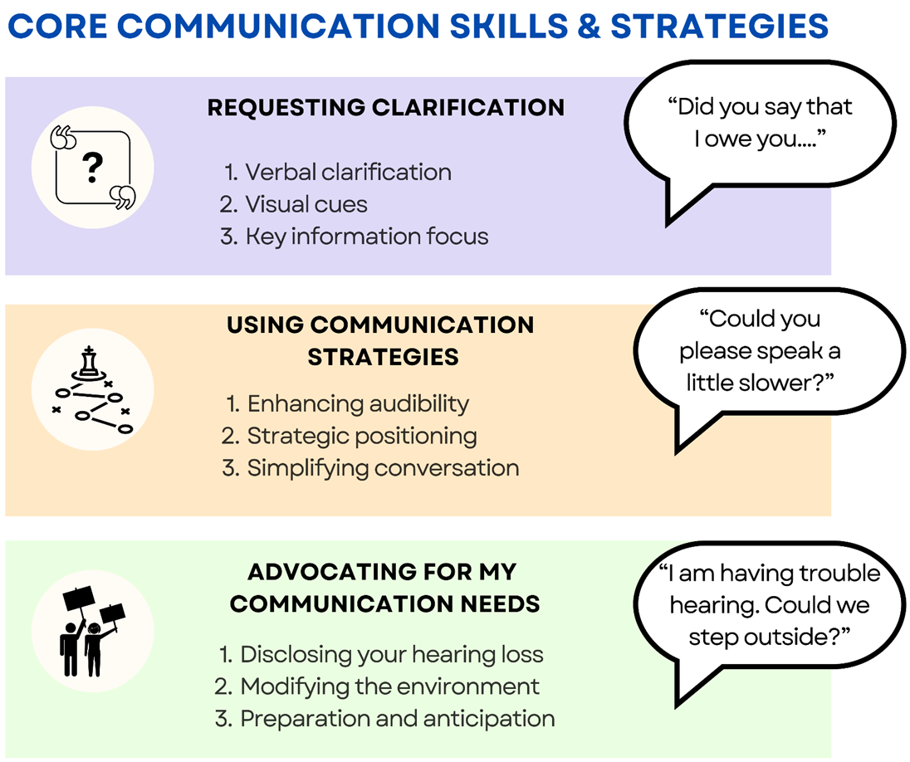
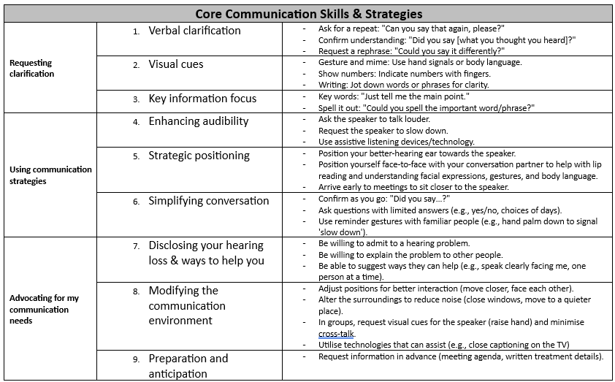
Core Communication Skills and Strategies
In your ACE Your Hearing workbook, you'll see that there are some vital skills that we call 'Core Communication Skills and Strategies.’
These are special tricks and tips that help you to communicate your needs and listen better in your everyday life.
We will use the 'Core Communication Skills and Strategies’ in each module. So keep these close!
Pages 14 & 15 of workbooks

Slide 9
Video: Core communication skills and strategies

Slide 10
Assertiveness tips:
Use "I" statements: Express yourself by starting sentences with "I" to avoid sounding accusatory and to take ownership of your emotions. E.g., “I have a hearing loss and I didn’t catch what you said.”
Be clear and direct: Communicate your needs and thoughts succinctly to avoid misunderstandings.
Maintain a calm tone: Keep your voice calm and steady, which helps in keeping discussions constructive, even during disagreements.
Express understanding: Before presenting your point of view or needs, start by acknowledging the other person’s position. This does not mean you have to agree with them, but shows respect for their position.
Being assertive:
Being assertive is critical for managing communication problems with hearing loss.
You need to disclose your hearing loss, and then assertively suggest ways that other people can help you.
Hiding your hearing loss can lead to more misunderstandings and problems.
Assertiveness is firm, but respectful.
Assertiveness is positive and constructive.
Page 16 of workbooks

Slide 11
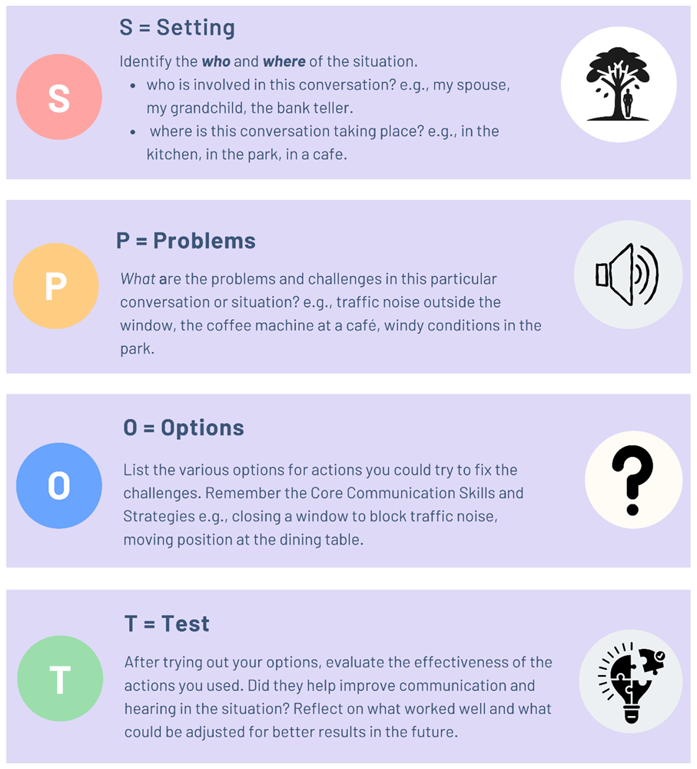
SPOT The Problem
A simple problem-solving process that helps you tackle communication challenges in their daily lives.
This approach guides you to think about communication issues and find solutions.
At the start of the scenario’s, participants work through the SPOT steps.
The goal is not just to solve the scenario presented, but to teach you a way of thinking that you can use in any setting or situation.
Page 17 of workbooks

Slide 12
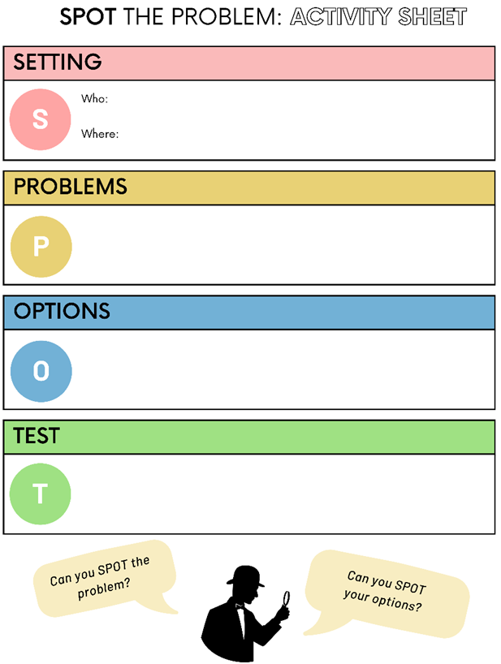

Most scenarios presented in the workbooks will have the SPOT The Problem activity sheet that you can fill out.

Slide 13
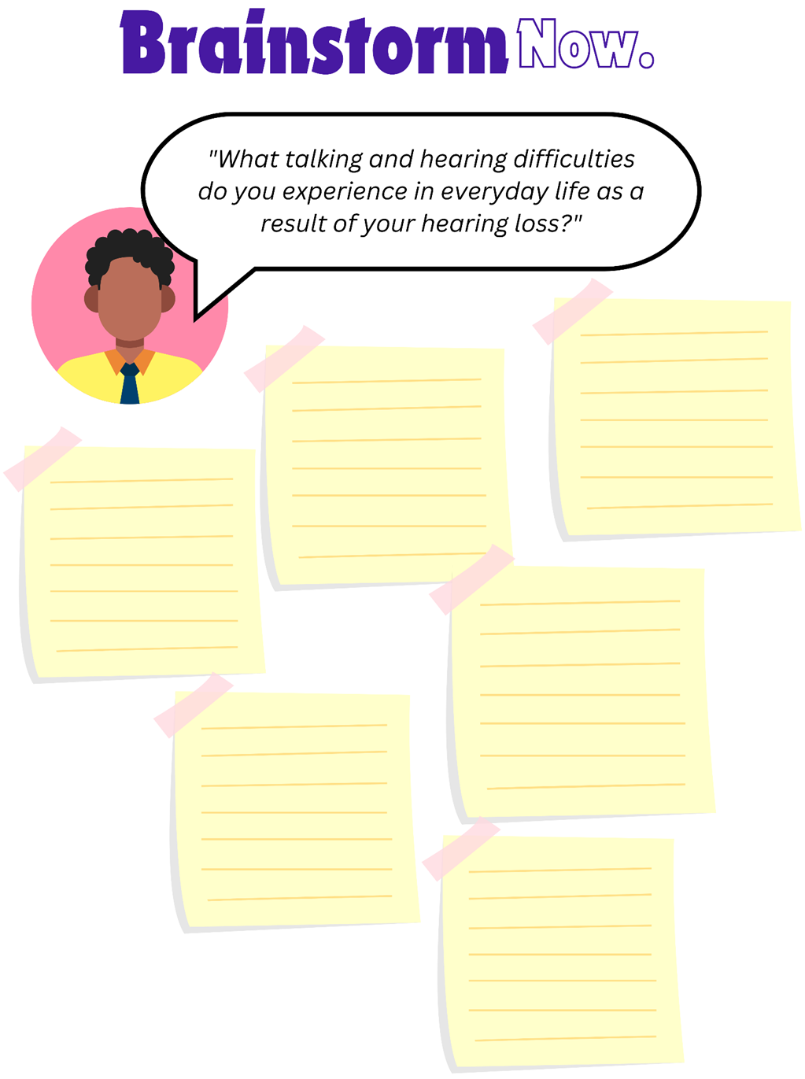
Now, let’s get ready to start!
To decide which Pick-and-Choose modules you will complete and/or which order, we firstly need to brainstorm the most common problems that hearing loss causes you.
"What talking and hearing difficulties do you experience in everyday life as a result of your hearing loss?”
Take a minute to write your answers on the post-it notes on page 19.
Go around the group and ask each person to share ONE difficulty at a time until all covered. The facilitator will write each answer on a board/poster underneath the module they match best with.
Page 19 of workbooks

Slide 14
Once you have completed the brainstorming:
Your facilitator will give you three post-it notes
These notes will have a number 1, 2 or 3 on them
1 = The most important problem for you
2 = The second most important problem to you
3 = The third most important problem to you
You will be asked to go up to the board and place your post-it notes next to the three problems that are most important to you.
Your facilitator will then calculate the scores
Example of post-it notes on a whiteboard

Slide 15
Thank you
Dr Jasmine Foley
School of Health and Rehabilitation Sciences
The University of Queensland
Jasmine.foley@uq.edu.au

