Slide 1
ACE Your Hearing
Core Module 2: Introduction to Common Challenging Environments for People with Hearing Loss

Slide 2
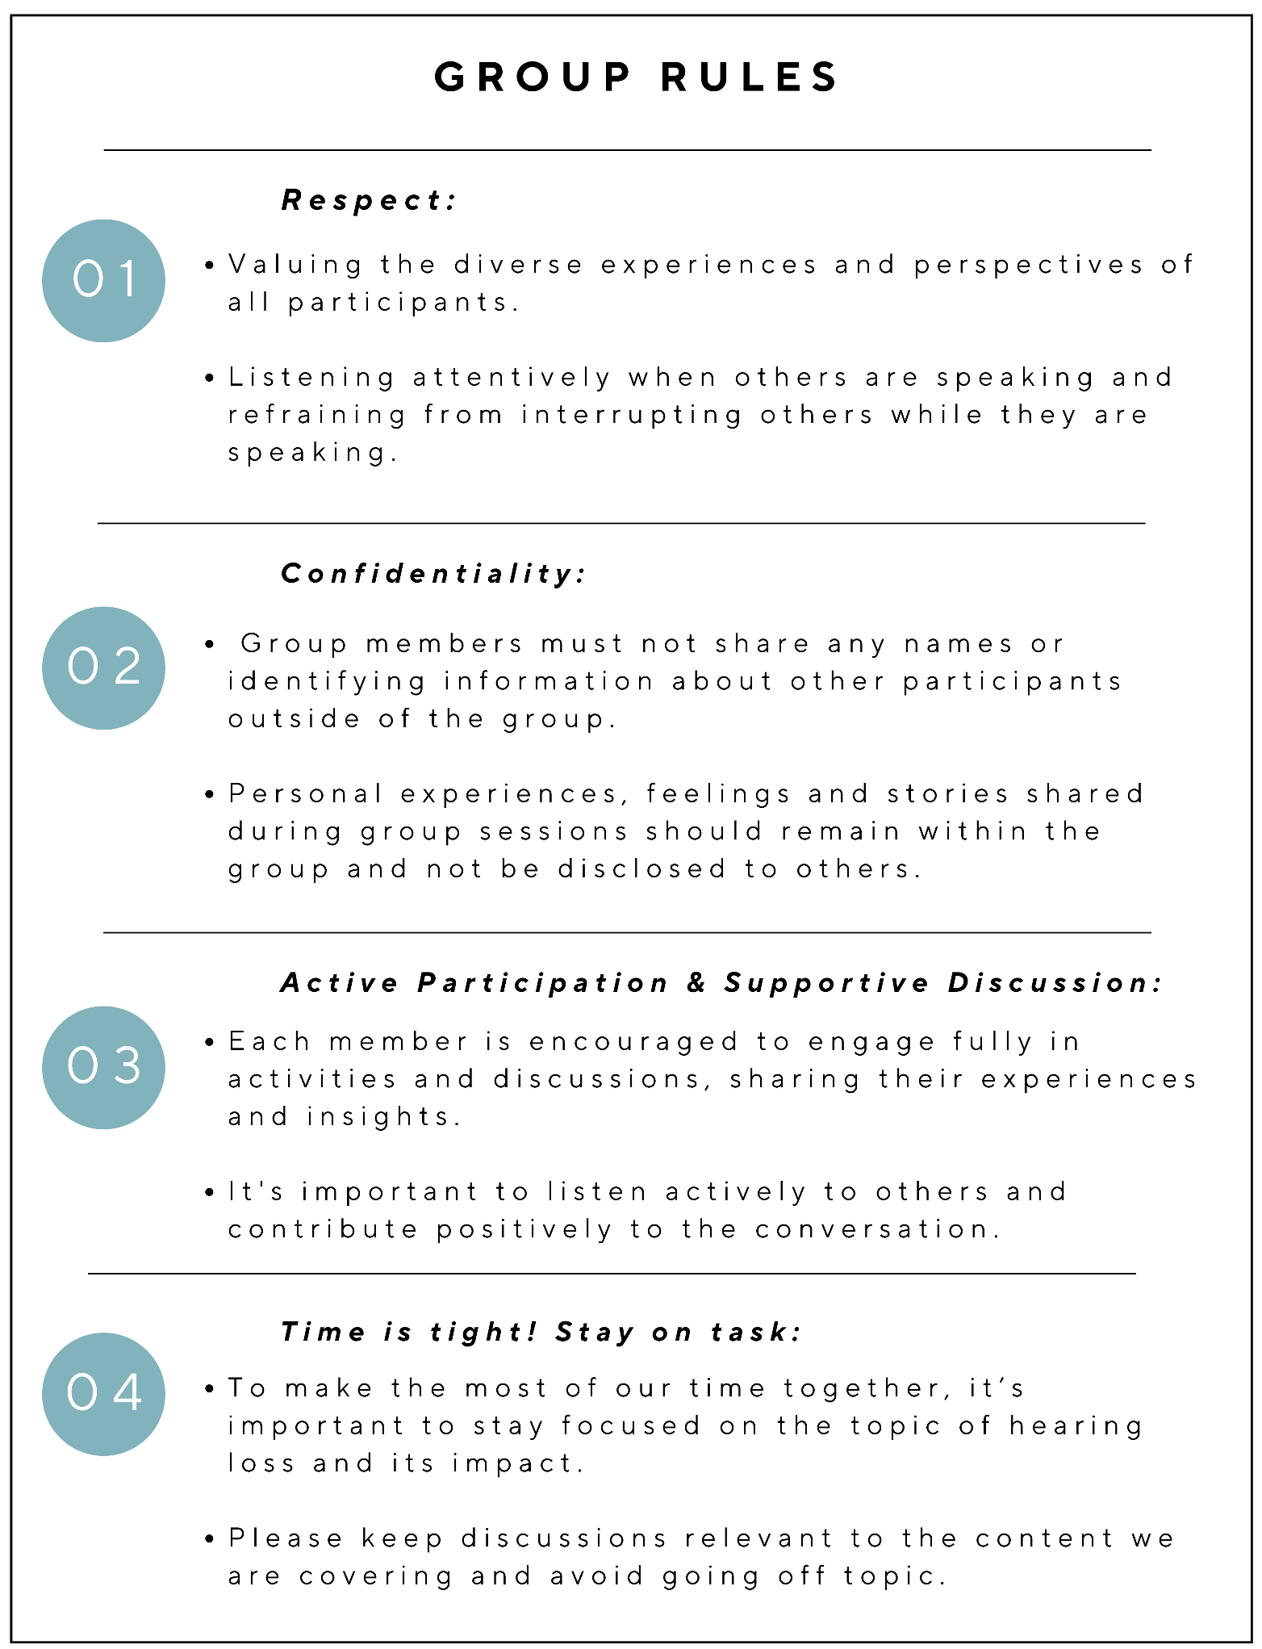
Group Rules Recap:
Respect
Confidentiality
Active Participation & Supportive Discussion
Time is tight! Stay on task
Page 9 of workbooks
Notes:
Before we get started on this module, I would like to quickly recap our group rules. So remember, we always respect our other group members experiences and perspectives, we maintain confidentiality and don’t share personal information outside the group, we participate and share and support each other in the discussions, and we must remember to keep our focus on hearing loss and not get lost going down tangents or sharing experiences that are not related to the content we need to cover.

Slide 3

Video: Introduction to common challenging communication environments

Slide 4
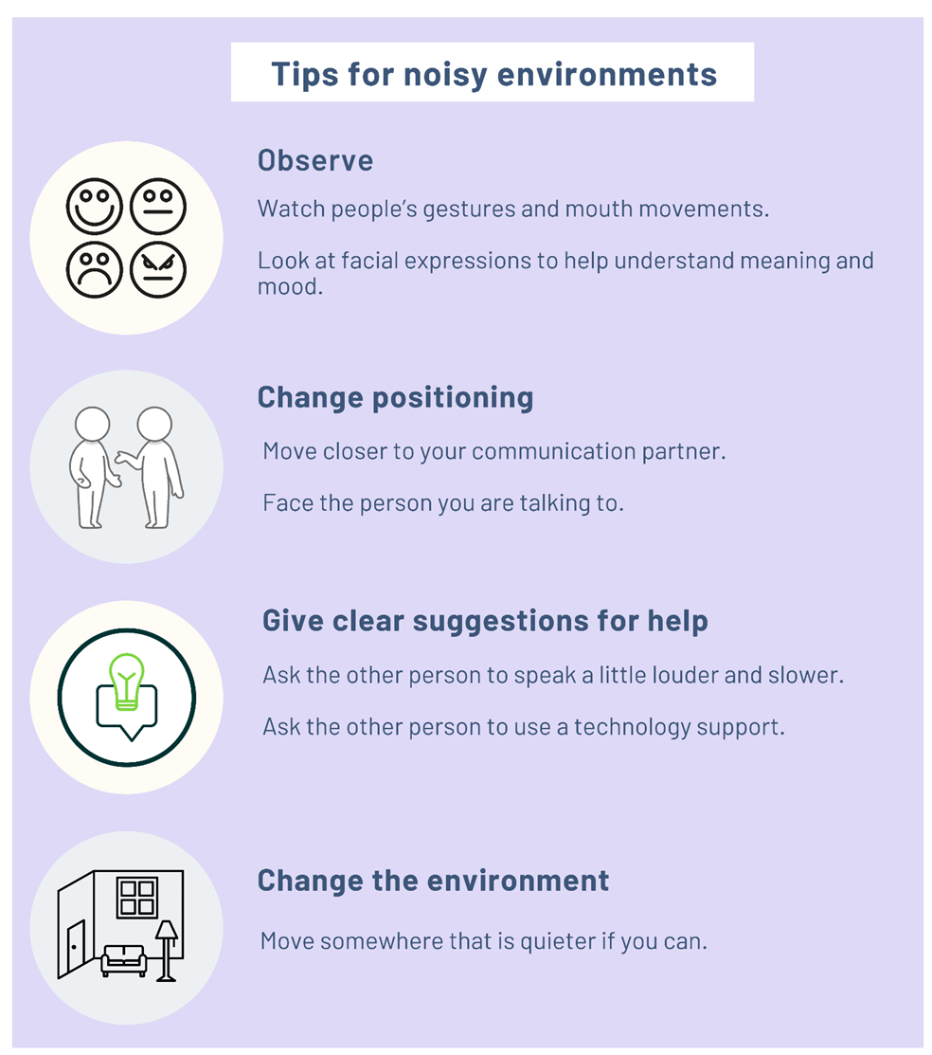
Introduction to Noisy and Group Environments
Everyone has difficulty talking in noisy and group environments, however, people with a hearing loss have more difficulty.
Noisy environments can include:
- restaurants
- cars/public transport
- shopping centres
- parks and windy areas, and
- busy social settings/groups of people
Noises can come from many sources, including talking, laughing, footsteps, moving chairs, animals, food preparation, music & traffic sounds
Page 21 of workbooks

Slide 5
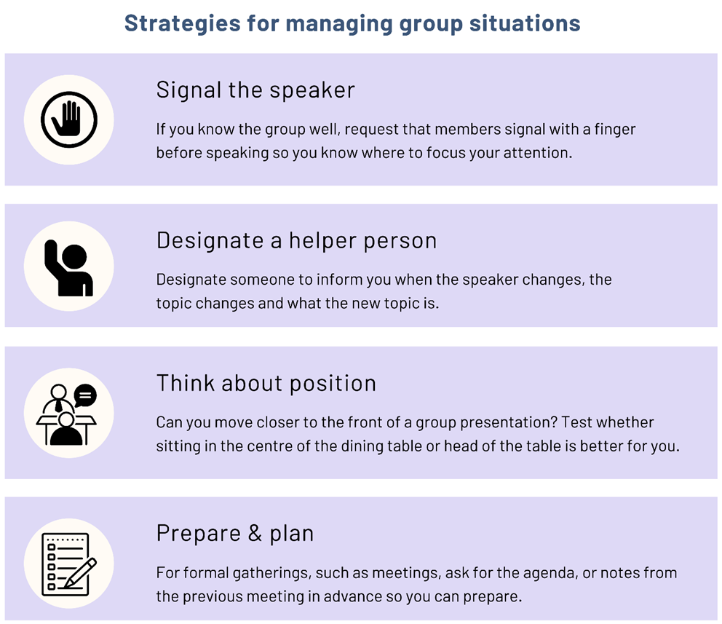
Talking in Group Situations
May be challenging due to:
Multiple people speaking all at once
Rapid shifts from one speaker to another
Frequent changes in the conversation topics
Page 22 of workbooks

Slide 6
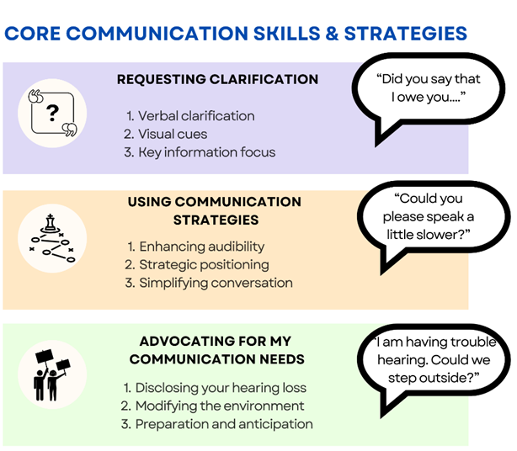
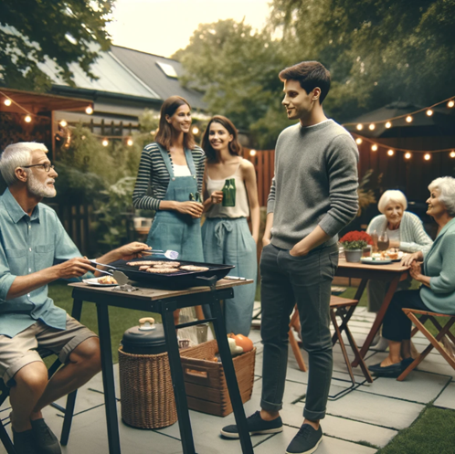
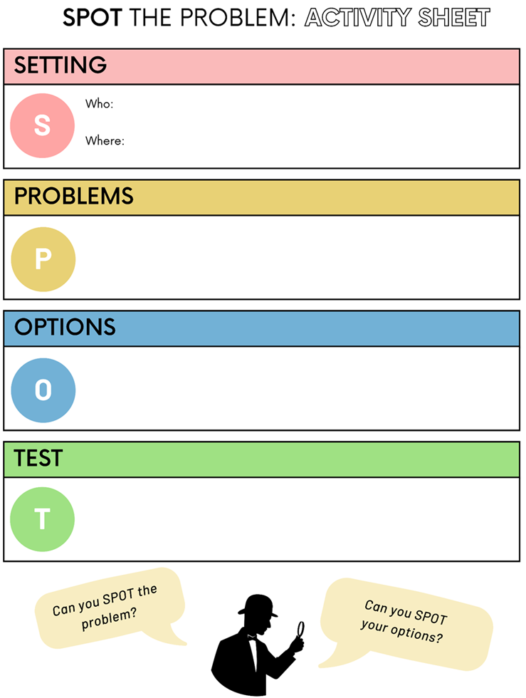
Scenario 1: Backyard barbeque
Joe is hosting a backyard barbeque to celebrate his birthday. His three children and their families have all come and are enjoying the nice spring weather outside. The family have gone to a lot of effort to make it a great party; putting up fairy lights and setting up outside speakers for the music. Joe is seated near the barbeque and his grandson is standing next to him, telling him about his new job. But Joe can’t hear him well.
Activity: complete the SPOT The Problem: Activity Sheet to explore solutions for this scenario
Remember your core skills and strategies as you do the SPOT The Problem activity

Slide 7
Scenario 1: Backyard barbeque
After 5 minutes:
Briefly detail the setting
Go around the group, each participant is to identify ONE problem each until all identified
Go around the group, each participant is to identify ONE option each to solve one of the problems until all identified
Go around the group, each participant is to identify ONE way to test and understand how or if the options identified would solve the problem
Stay focused and on task! Time is TIGHT.
Ensure everyone gets a turn to speak.

Slide 8
Scenario 1: Backyard BBQ
Turn to page 25 of your workbooks. Write some ideas and thoughts in the space provided for the three activity questions that accompany the Backyard BBQ Scenario. In a few minutes we will discuss these as a group.
Activity 1: How might Joe have felt in this scenario when he couldn’t hear what his grandson was saying?
Activity 2: How might the grandson have felt when Joe couldn’t hear what he was trying to tell him?
Activity 3: Would the solutions you identified help to improve the emotional and social experience of both Joe and his grandson? Why/why not?
Stay focused and on task! Time is TIGHT.
Ensure everyone gets a turn to speak.

Slide 9

Scenario 2: A busy café
You are at a café, having lunch with your partner and three other friends. After your meal, the waiter comes to ask how you would like to pay. Your group requested separate bills and the waiter is telling each of you your totals. You did not hear how much the staff member said you owed as the café is very noisy and the coffee machine nearby is making it very difficult to hear
Remember your core skills and strategies as you do the SPOT The Problem activity
Activity: complete the SPOT The Problem: Activity Sheet to explore solutions for this scenario

Slide 10
Scenario 2: A busy café
After 5 minutes:
Briefly detail the setting
Go around the group, each participant is to identify ONE problem each until all identified
Go around the group, each participant is to identify ONE option each to solve one of the problems until all identified
Go around the group, each participant is to identify ONE way to test and understand how or if the options identified would solve the problem
Stay focused and on task! Time is TIGHT.
Ensure everyone gets a turn to speak.

Slide 11
Scenario 2: A busy cafe
Turn to page 28 of your workbooks. Write some ideas and thoughts in the space provided for the three activity questions that accompany the café scenario. In a few minutes we will discuss these as a group.
People with hearing loss workbooks:
Activity 1: If you were at this café with a family member or friend, would you like them to help you in this scenario? Would you like them to intervene or not?
Activity 2: Have you been in a similar situation before? How did you feel in that situation?
Activity 3: Some people with hearing loss struggle in noisy environments so much that they stop wanting to go to certain places like café’s and restaurants. What social and emotional difficulties might they experience if they stop attending these kinds of events with family and friends?
Family and friends' workbooks:
Activity 1: What could you do in this scenario to help? Think about whether or not the person with hearing loss would like you to intervene?
Activity 2: Has your family member or friend with a hearing loss been in a similar situation before? How do you think they felt at that time?
Activity 3: Some people with hearing loss struggle in noisy environments so much that they stop wanting to go to certain places like café’s and restaurants. What social and emotional difficulties might they experience if they stop attending these kinds of events with family and friends?

Slide 12
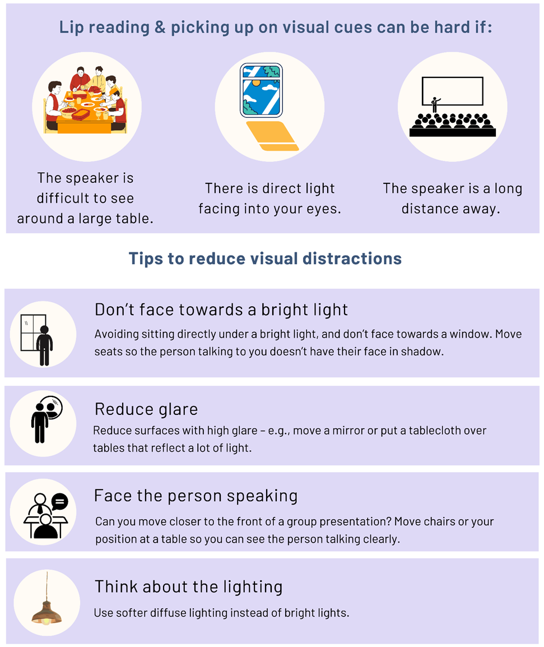
Lip reading and visual distractions
Page 29 of your workbooks
Many people with hearing difficulties rely on lip reading and other visual clues, like facial expressions.
Visual orientation to the communication partner is very important

Slide 13
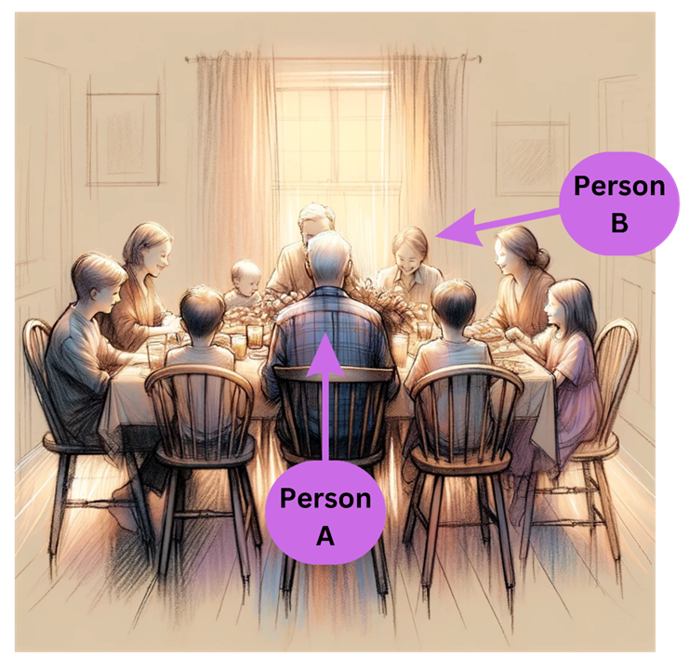
Scenario 3: Lighting distractions around the dinner table
Activity 1:
Look at Person A and Person B. Which person would have the greatest trouble seeing other members of the tables’ facial expressions and lip movements?
Circle your answer: Person A or Person B
Discuss with your group why you think that person would have more trouble.

Slide 14
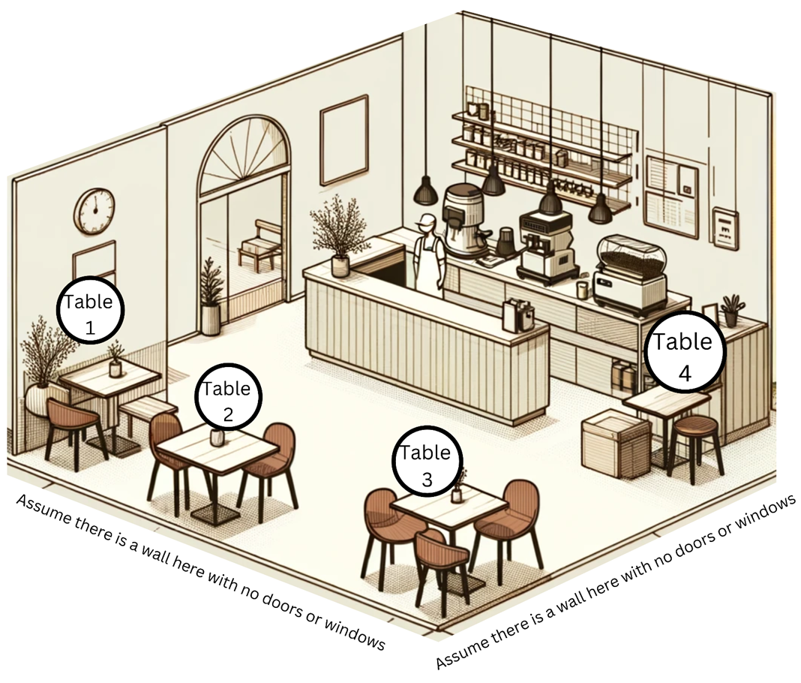
Bonus activity
Activity: Which table do you think might be the noisiest to sit at? Why?
Write down some notes in your workbook and then discuss with your group.

Slide 15
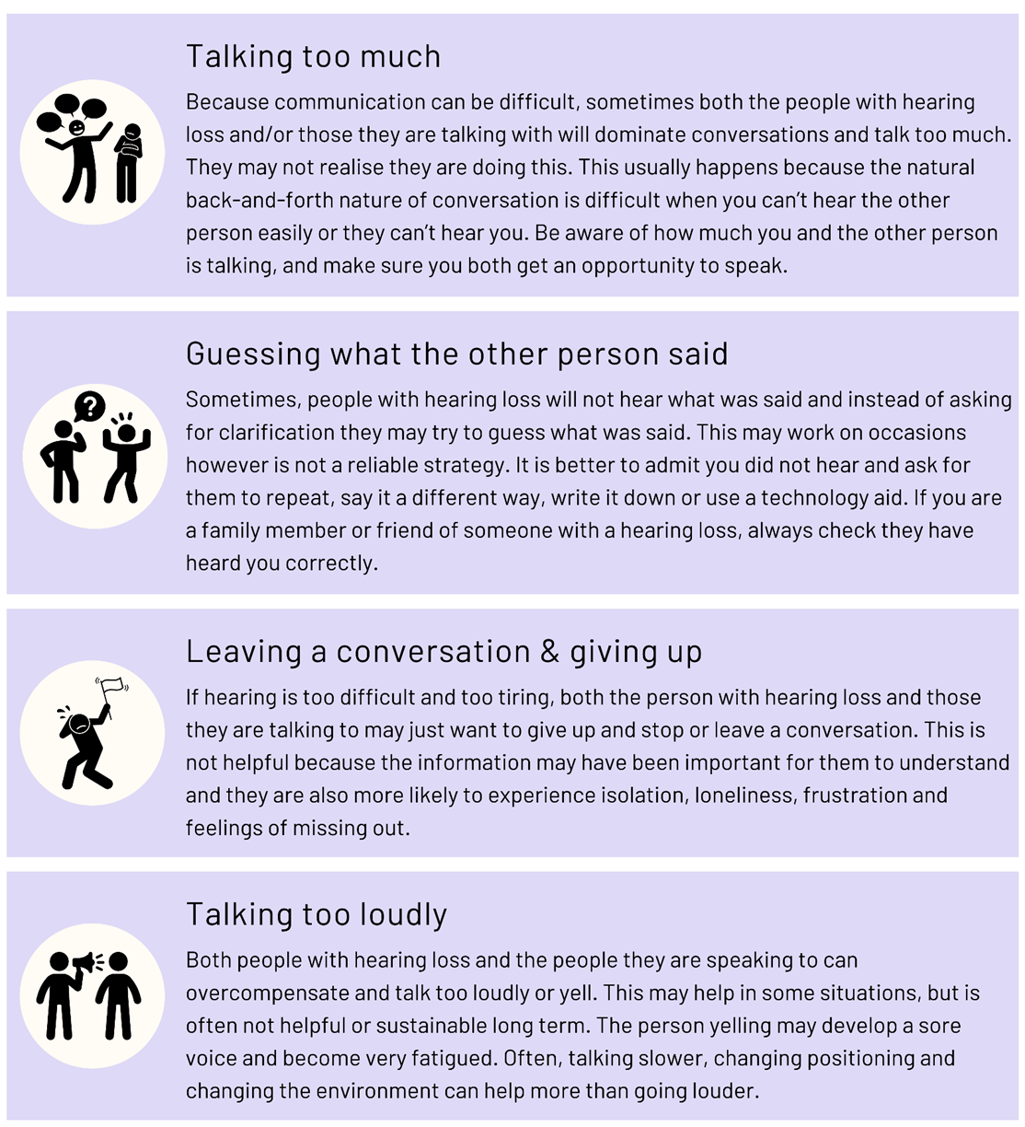
Bonus information: BAD HABITS
Did you know….
People with hearing loss AND the people talking to them can form bad habits or unhelpful strategies in their communication?
It can affect one or both parties.
The person may not know they have developed bad habits or unhelpful strategies.
See page 32 of your workbooks.

Slide 16
Thank you
Dr Jasmine Foley
School of Health and Rehabilitation Sciences
The University of Queensland
Jasmine.foley@uq.edu.au

