Slide 1
ACE Your Hearing
Pick & Choose Module 3: Tuning in to technology - TV, Phones, Computers and Public Address Systems

Slide 2
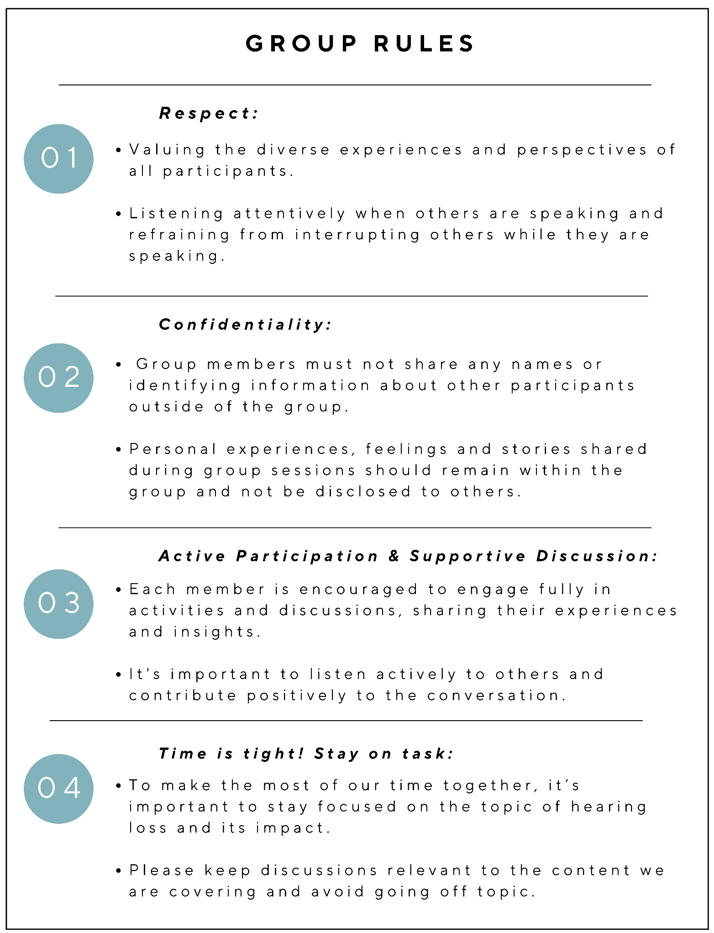
Group Rules Recap:
Respect
Confidentiality
Active Participation & Supportive Discussion
Time is tight! Stay on task
Page 9 of workbooks
Notes:
Before we get started on this module, I would like to quickly recap our group rules. So remember, we always respect our other group members experiences and perspectives, we maintain confidentiality and don’t share personal information outside the group, we participate and share and support each other in the discussions, and we must remember to keep our focus on hearing loss and not get lost going down tangents or sharing experiences that are not related to the content we need to cover.

Slide 3

Video: Tuning in to technology

Slide 4
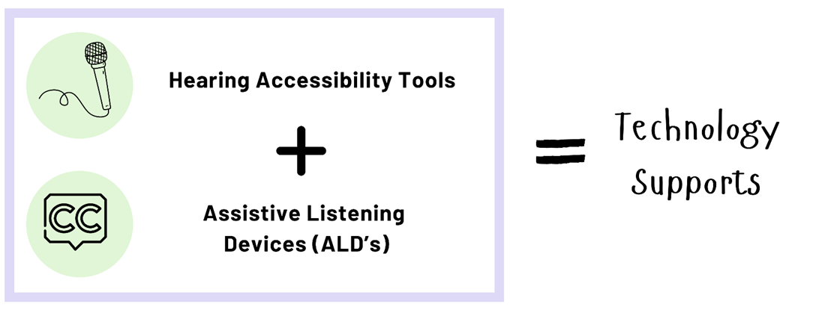
Technology supports are commonly divided into two categories: 1) hearing accessibility tools, and
2) assistive listening devices (ALDs).
In ACE Your Hearing, we simplify this and refer to both as technology supports.
Technology supports can include:
Earphones
Microphones
Visual alert systems
Hearing loops
Speech-to-text apps
Closed captioning
Amplified phones
Sound recognition apps
Bluetooth devices and auracast
AND MORE!

Slide 5
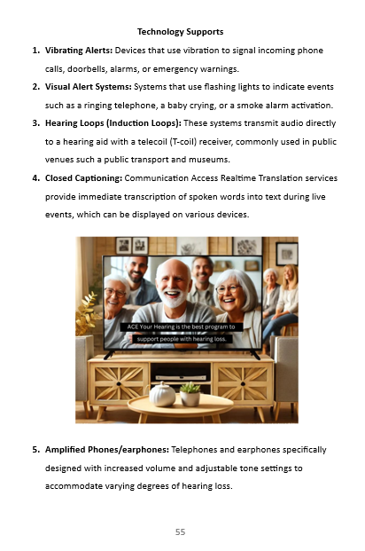
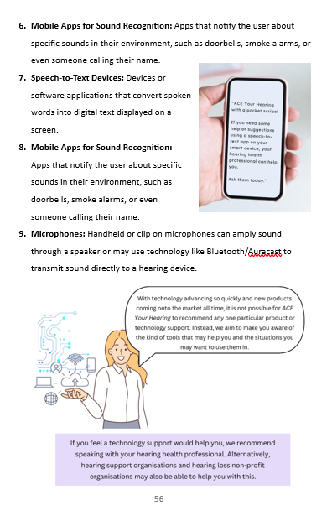
Examples of technology supports:
If you did not watch the video, please briefly go through the list of example technology supports on pages 55 and 56.
If you did watch the video, you have covered most of these and can move onto the first scenario.
Page 55 & 56
of workbooks

Slide 6
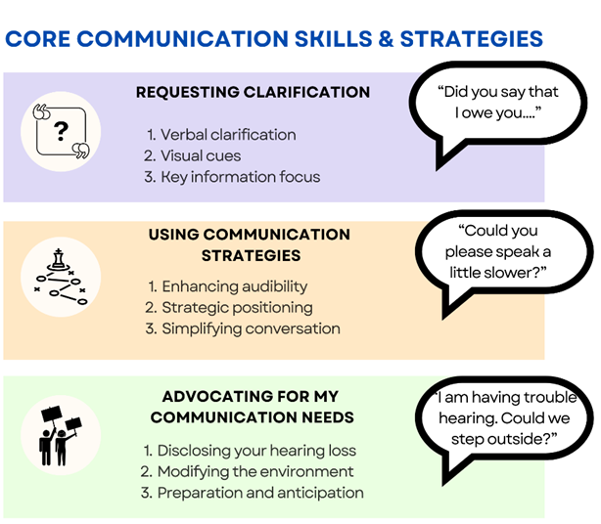
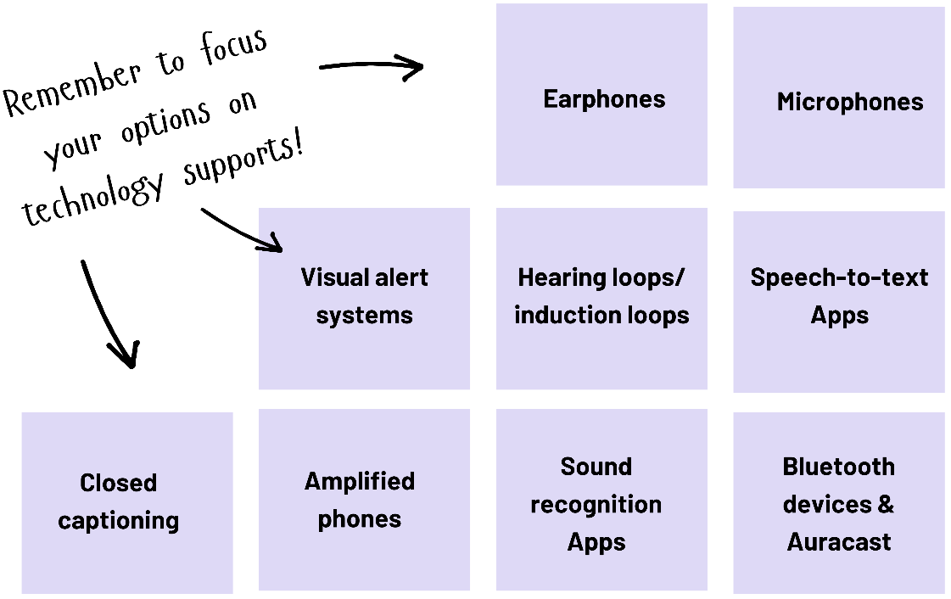

Scenario 1: Watching the television
Bob and Alice enjoy their evening TV shows together. Bob has worn hearing aids for a few years but has not tried to use any accessibility tools or assistive listening devices. Even though Bob wears hearing aids to watch TV, he has always had some trouble hearing people talking on the shows. Recently, Alice has had trouble hearing the dialogue too, even when the volume is up and increasing the volume too high makes the hearing aids uncomfortable for Bob.
Activity: complete the SPOT The Problem: Activity Sheet to explore solutions for this scenario

Slide 7
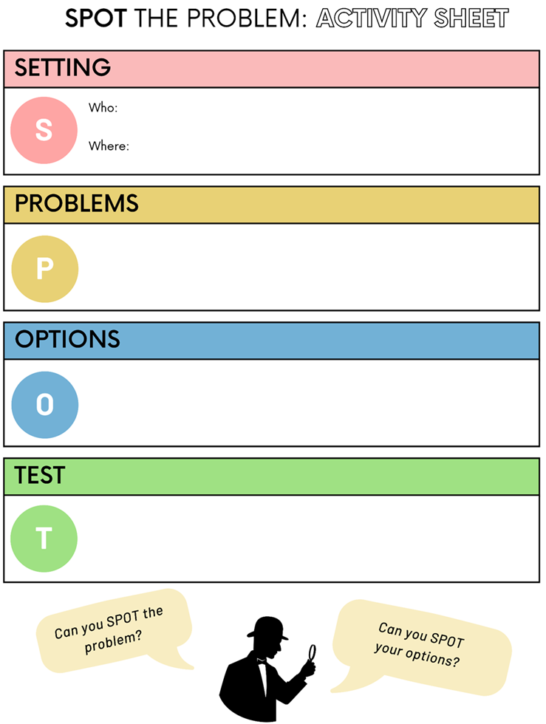
After 5 minutes:
Briefly detail the setting
Go around the group, each participant is to identify ONE problem each until all identified
Go around the group, each participant is to identify ONE option each to solve one of the problems until all identified
Go around the group, each participant is to identify ONE way to test and understand how or if the options identified would solve the problem
Stay focused and on task! Time is TIGHT.
Ensure everyone gets a turn to speak.

Slide 8
Turn to page 59 of your workbooks. Write some ideas and thoughts in the space provided for the activity questions that accompany this scenario. In a few minutes we will discuss these as a group.
Activity 1: How might Bob feel when he struggles to hear the dialogue on TV despite wearing his hearing aids?
Activity 2: What feelings might Alice experience when she has to ask for the volume to be turned up, knowing it might make Bob uncomfortable?
Activity 3: What might be the social and emotional benefits for both Bob and Alice if they explore and implement additional hearing solutions like technology supports?

Slide 9


Scenario 2: Attending a public talk
Jane, an art enthusiast with moderate hearing loss, has always liked going to talks held at the art gallery. As her hearing has worsened and the sessions become busier with more people shuffling around and talking, she has noticed she can no longer hear the speaker properly. Her friend mentioned that public venues often have some technology tools to help and has seen other people ask for them in the past, but she’s not sure what they are or how they work. Unsure of the best way to address her needs, she feels anxious about missing important details and fully engaging with the presentation.
Activity: complete the SPOT The Problem: Activity Sheet to explore solutions for this scenario

Slide 10
After 5 minutes:
Briefly detail the setting
Go around the group, each participant is to identify ONE problem each until all identified
Go around the group, each participant is to identify ONE option each to solve one of the problems until all identified
Go around the group, each participant is to identify ONE way to test and understand how or if the options identified would solve the problem
Stay focused and on task! Time is TIGHT.
Ensure everyone gets a turn to speak.

Slide 11
Turn to page 59 of your workbooks. Write some ideas and thoughts in the space provided for the activity questions that accompany this scenario. In a few minutes we will discuss these as a group.
Activity 1: How do you think Jane felt about asking for assistive listening devices before the talk?
Activity 2: How do you think the use of ALDs might affect Jane’s ability to engage with the presentation?
Activity 3: In what ways might a positive experience in this situation influence her attendance at future public events?
Activity 4: In what ways might a negative experience in this situation influence her attendance at future public events?

Slide 12
Scenario 3: Attending an exercise class
Jane, an art enthusiast with moderate hearing loss, has always liked going to talks held at the art gallery. As her hearing has worsened and the sessions become busier with more people shuffling around and talking, she has noticed she can no longer hear the speaker properly. Her friend mentioned that public venues often have some technology tools to help and has seen other people ask for them in the past, but she’s not sure what they are or how they work. Unsure of the best way to address her needs, she feels anxious about missing important details and fully engaging with the presentation.
Activity: complete the SPOT The Problem: Activity Sheet to explore solutions for this scenario

Slide 13
After 5 minutes:
Briefly detail the setting
Go around the group, each participant is to identify ONE problem each until all identified
Go around the group, each participant is to identify ONE option each to solve one of the problems until all identified
Go around the group, each participant is to identify ONE way to test and understand how or if the options identified would solve the problem
Stay focused and on task! Time is TIGHT.
Ensure everyone gets a turn to speak.

Slide 14
Turn to page 65 of your workbooks. Write some ideas and thoughts in the space provided for the activity questions that accompany this scenario. In a few minutes we will discuss these as a group.
People with hearing loss workbooks:
Activity 1:What emotions arise when you miss important instructions from others (whether in an exercise class or elsewhere)?
Activity 2: Have you ever felt embarrassed or self-conscious about asking for help or clarifications in group situations like this?
Family and friends workbooks:
Activity 1:How do you feel watching your family member or friend with a hearing loss struggle to hear important instructions?
Activity 2: Does their hearing difficulty impact how you are able to enjoy group activities like this?
Activity 3: Many people with hearing loss feel embarrassed or self-conscious about asking for help or clarifications in group situations like this. How do you think your family member/friend feels in these kinds of situations?

Slide 15
Thank you
Dr Jasmine Foley
School of Health and Rehabilitation Sciences
The University of Queensland
Jasmine.foley@uq.edu.au

