Slide 1
Bridging the Digital Divide Celebration Event 24th November 2025

Slide 2

Acknowledgement of Country
The University of Queensland (UQ) acknowledges the Traditional Owners and their custodianship of the lands on which we meet.
We pay our respects to their Ancestors and their descendants, who continue cultural and spiritual connections to Country.
We recognise their valuable contributions to Australian and global society.
Image: Digital reproduction of A guidance through time by Casey Coolwell and Kyra Mancktelow
Notes:
Longer version
I acknowledge the Traditional Owners and their custodianship of the lands on which we meet today. On behalf of *, I pay our respects to their Ancestors and their descendants, who continue cultural and spiritual connections to Country. We recognise their valuable contributions to Australian and global society.
* If you are hosting an event, meeting or seminar, you might say something like, “On behalf of the event organisers or your section….”
Shorter version
I (too,) acknowledge the Traditional Owners and their custodianship of the lands on which we meet today and pay my respect to their Ancestors and their descendants.
You may wish to verbally include a line acknowledging the artwork and artists – “We extend our respect and acknowledge sisters and Quandamooka artists Casey Coolwell and Kyra Mancktelow for A guidance through time, the beautiful and powerful representation of reconciliation at UQ.”
Slide last updated February2023. Source: PVC(IE)/ATSISU (contact Nicole Rawson-Harris: uqrap@uq.edu.au).

Slide 3

Overview
Project aims
Experiences and priorities for improvement
Co-designing the browser extension
CommuniKey demonstration
Try CommuniKey
Testing CommuniKey
Next steps for CommuniKey
Thank you and afternoon tea

Slide 4
Housekeeping
Toilets outside near lifts
In case of emergency, fire exits are near the lifts. Assembly point is Post Office Square
Please ask questions any time

Slide 5

To ask a question
You can ask a question at any time
Raise your hand
Use the Chat on Zoom
Use the raise hand function

Slide 6
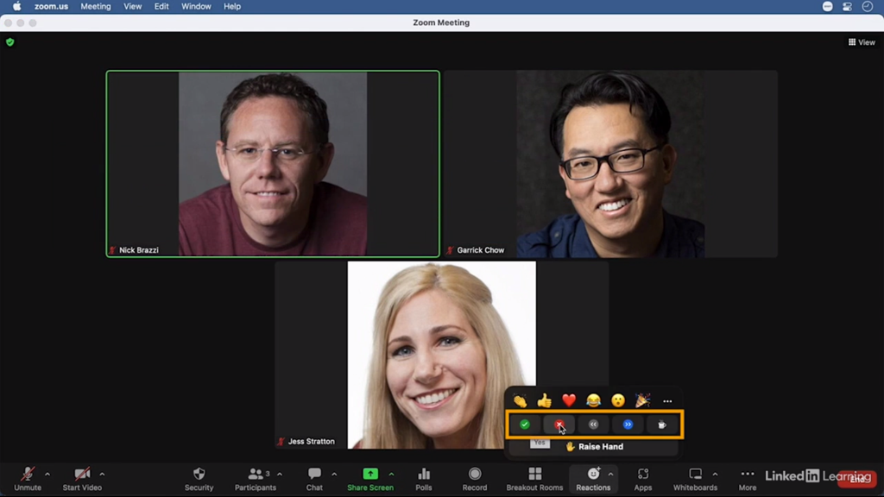
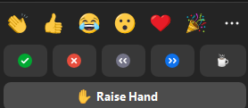

Slide 7



Funding
Bridging the Digital Divide: Building Health Self-Efficacy through Communication-Accessible Online Environments (MRF2019367). MRFF 2021 Consumer-Led Research Grant Opportunity.
UQ Foundation Research Excellence Award.
Associate Professor Sarah Wallace and Dr Kirstine Shrubsole are supported by National Health and Medical Research Council Emerging Leadership Investigator Grants.

Slide 8






Partners

Slide 9
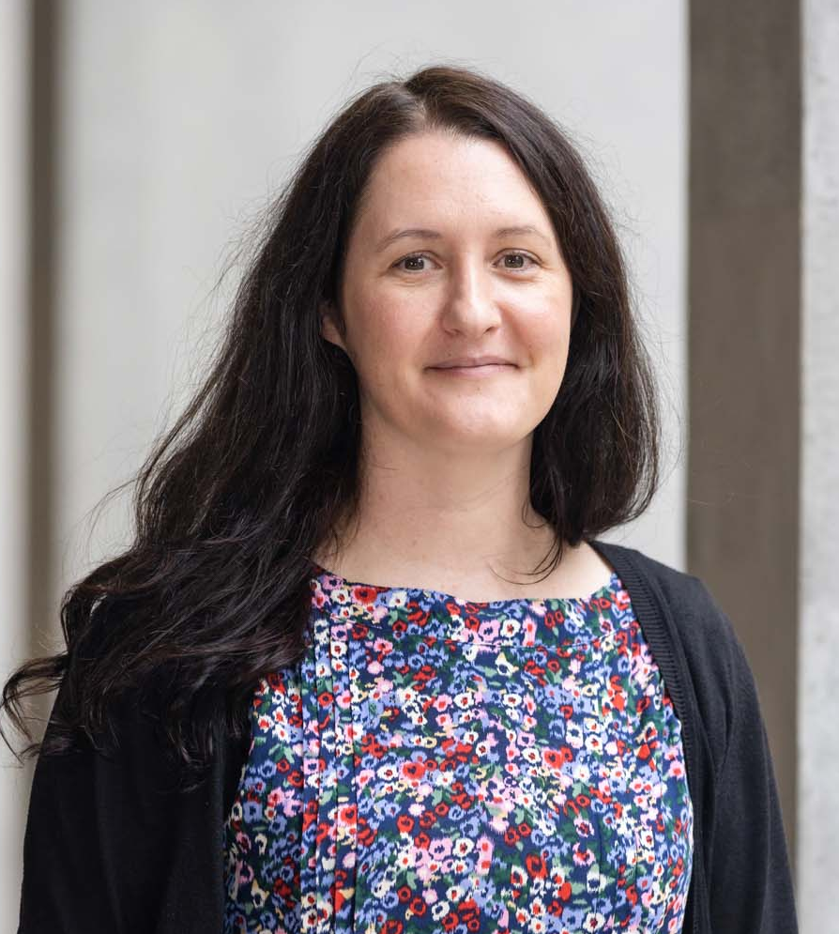
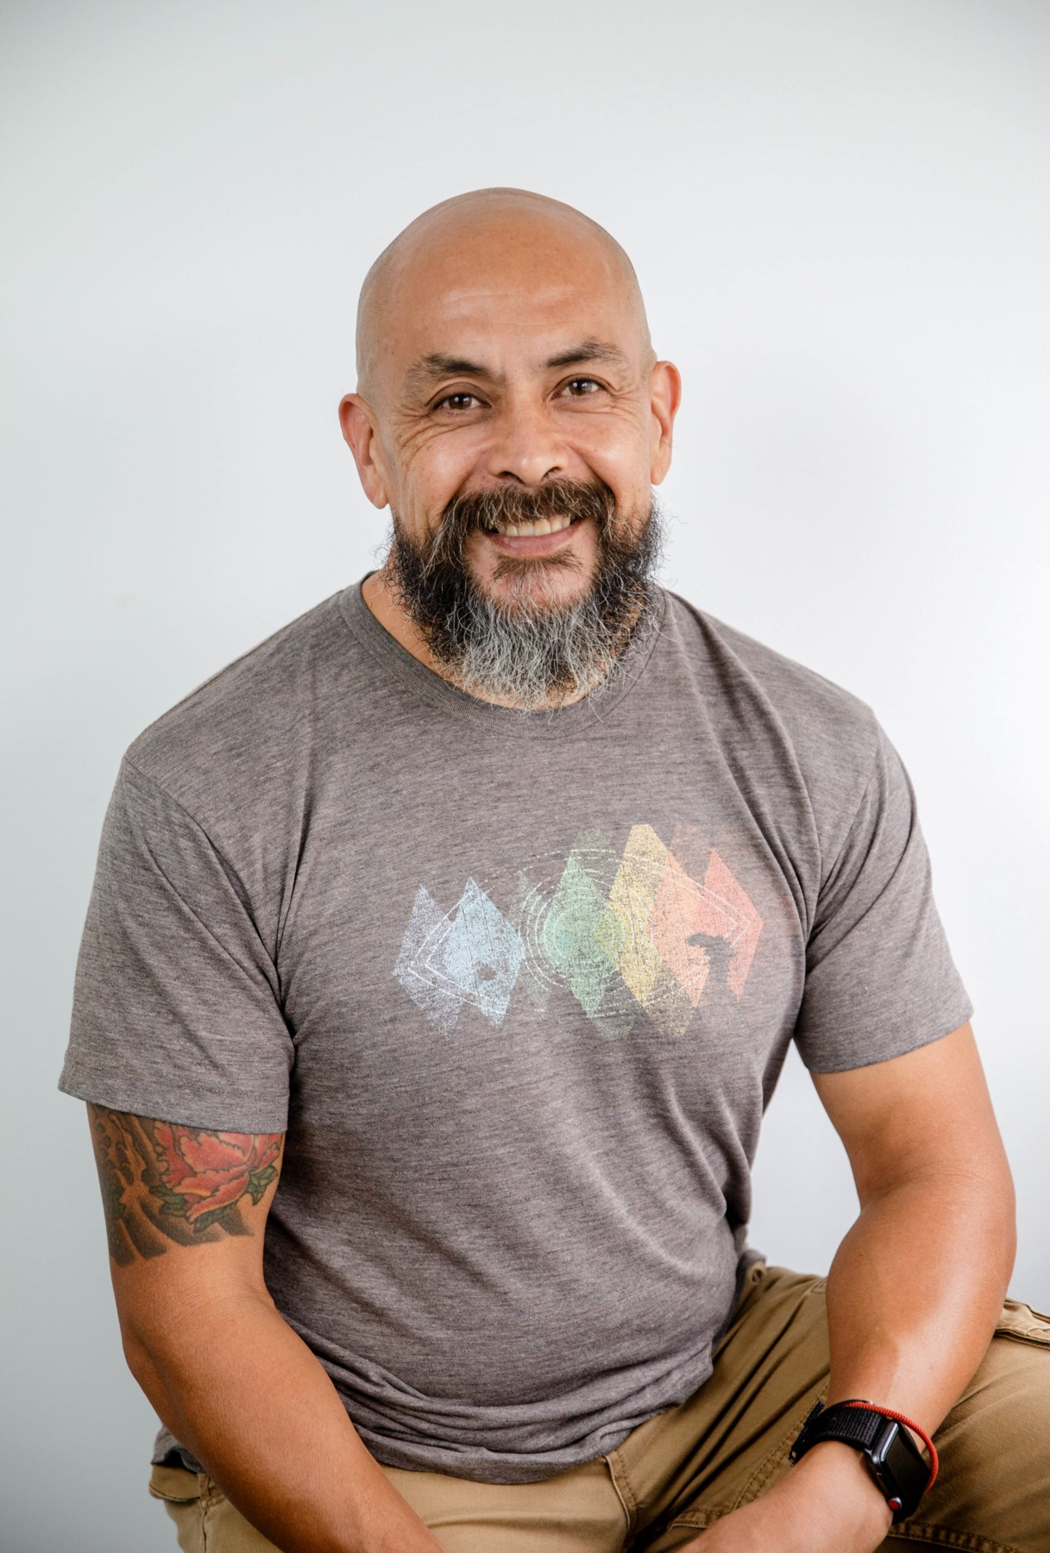
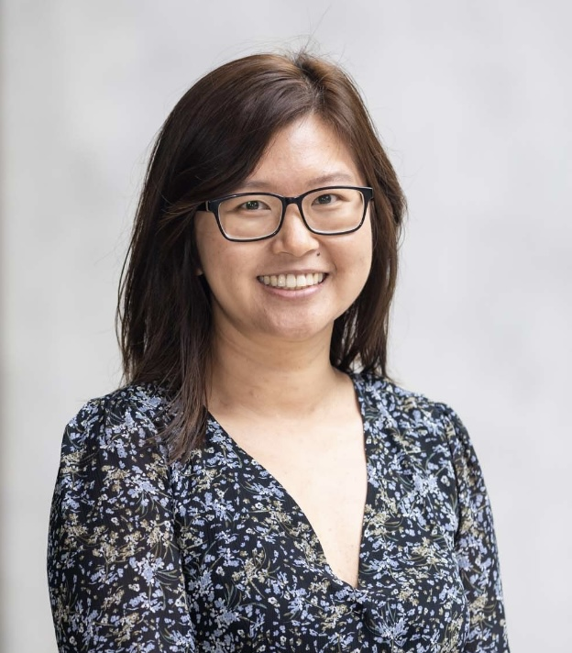
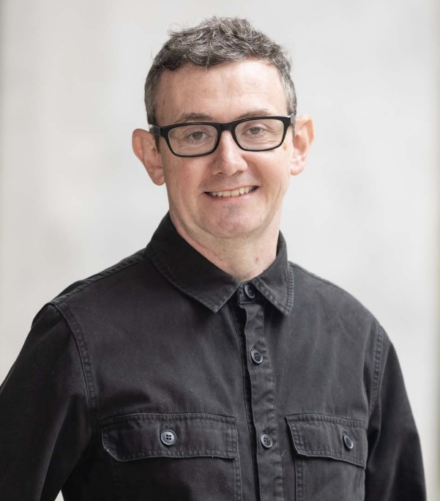
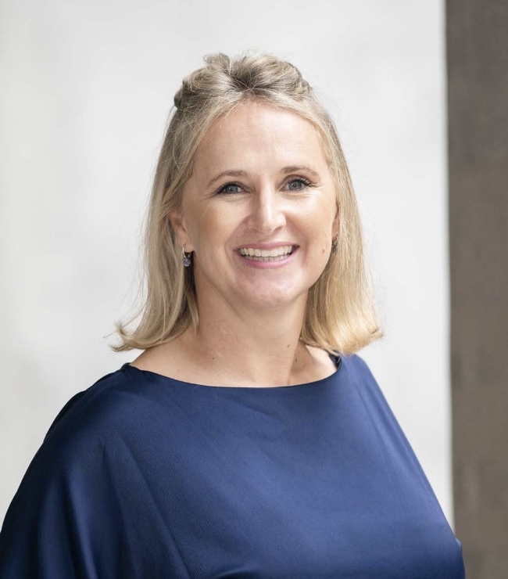
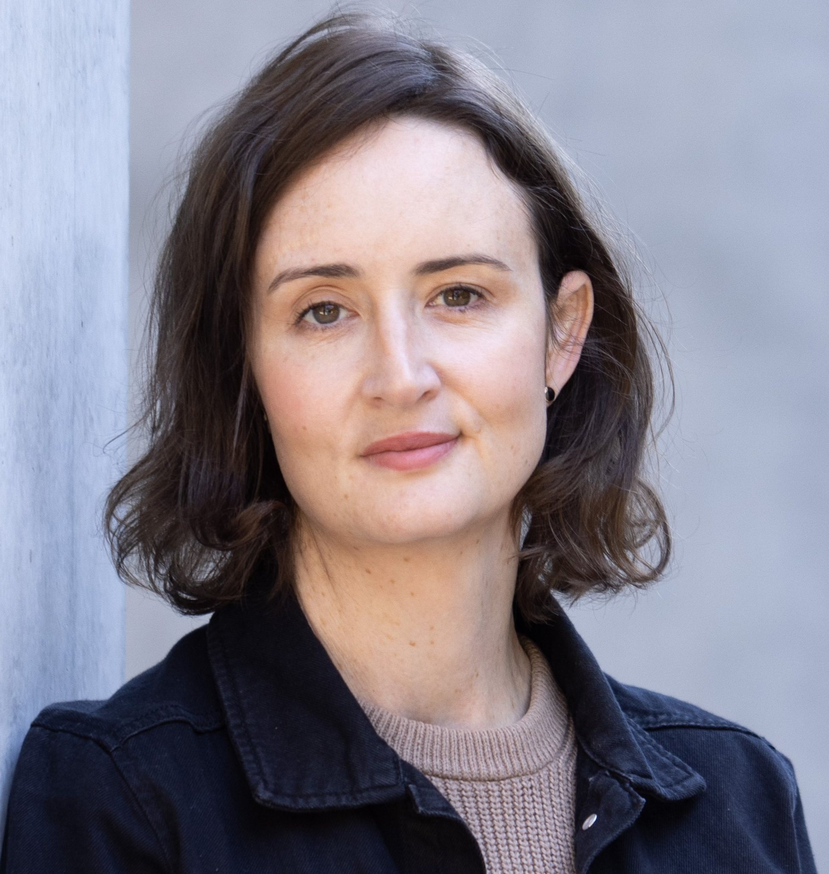


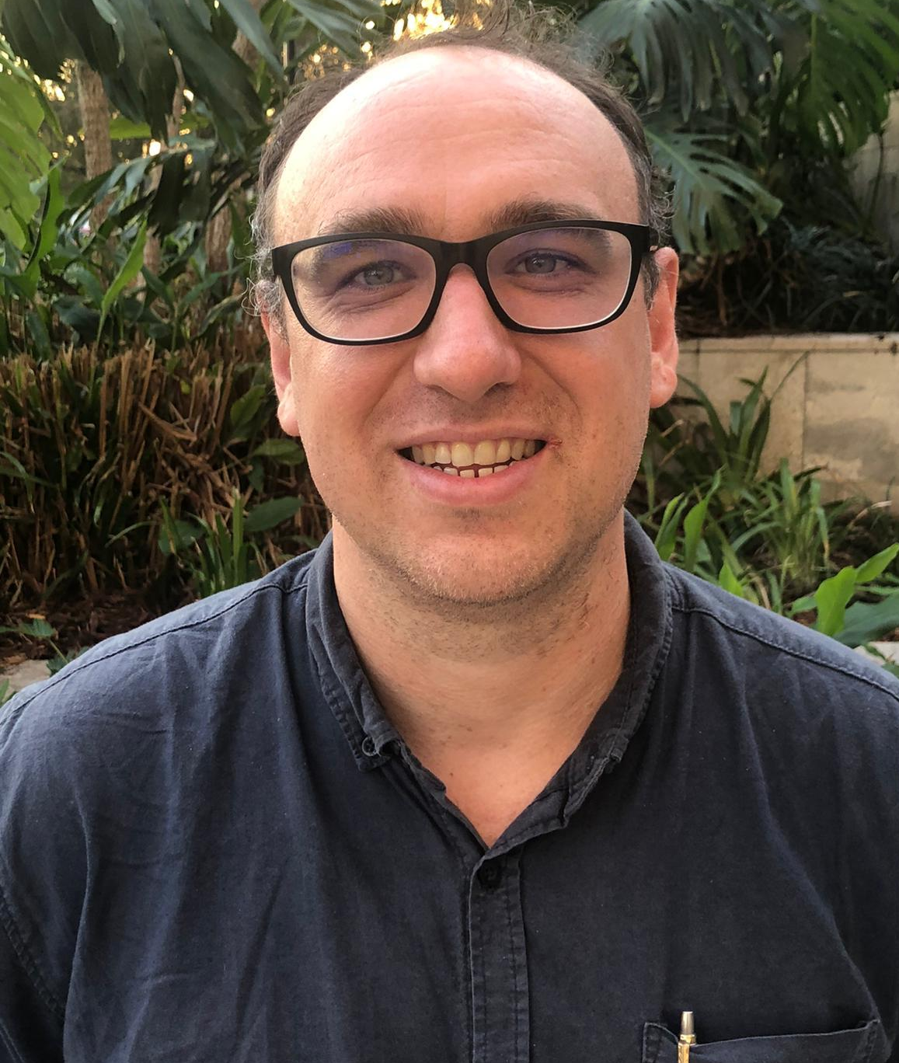
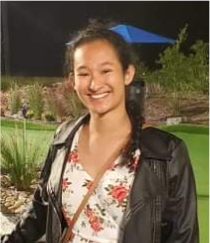
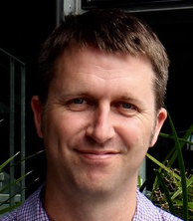
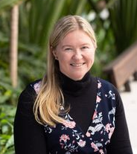
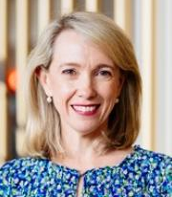
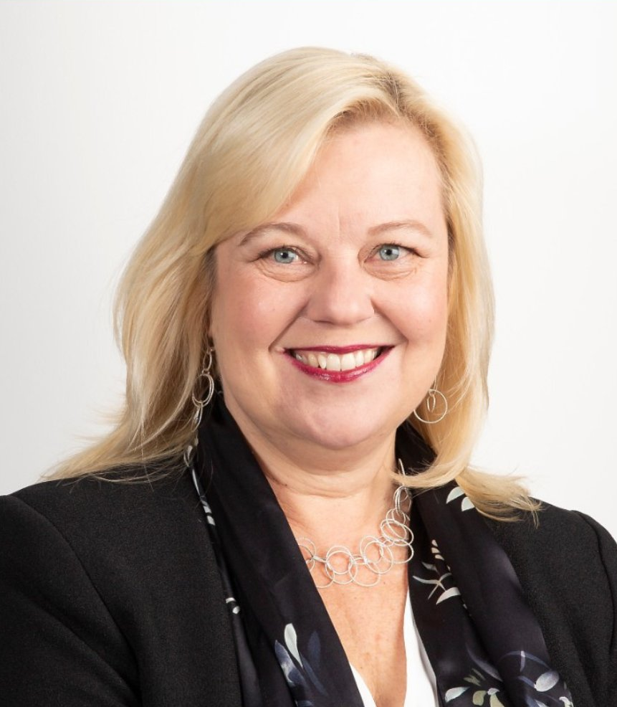

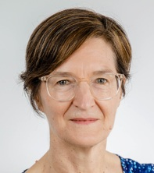
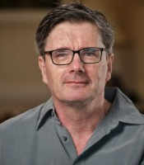
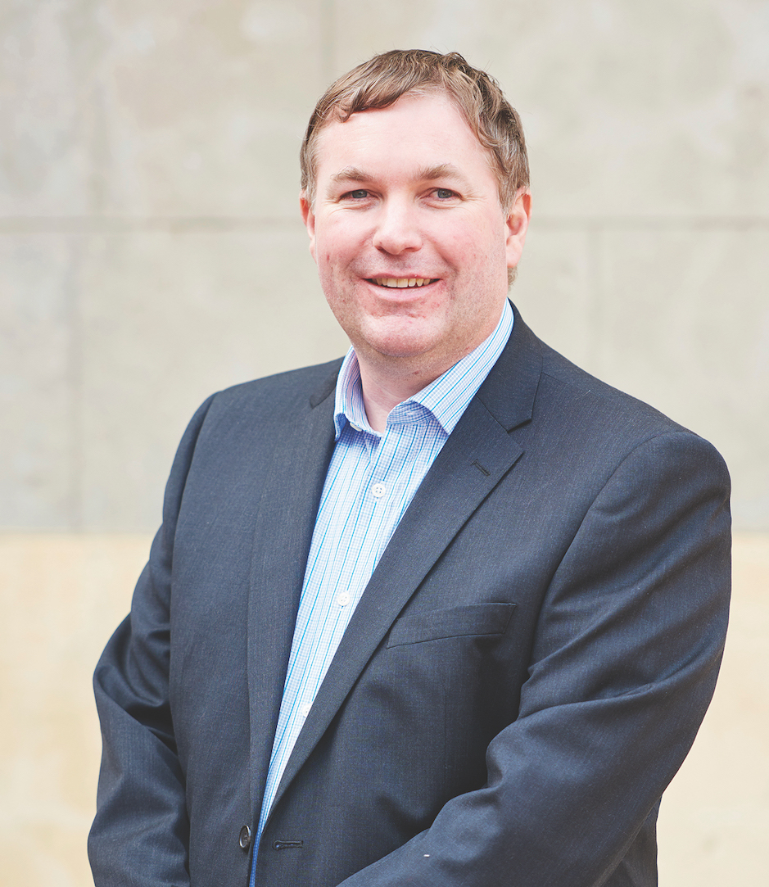
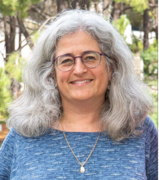
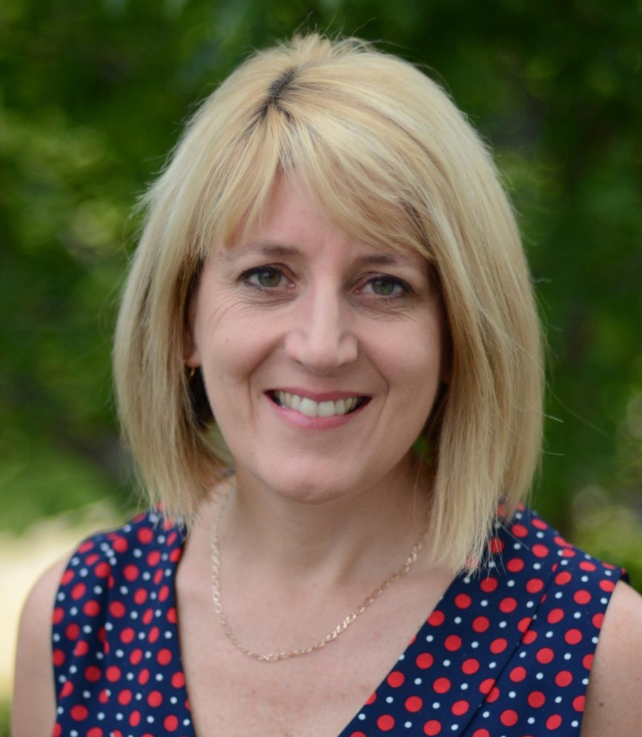
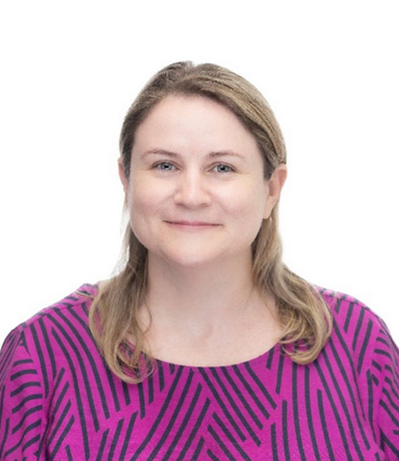


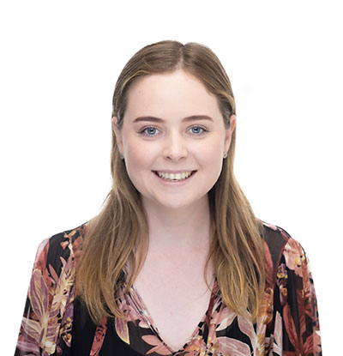
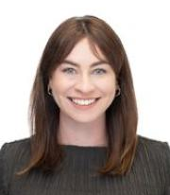
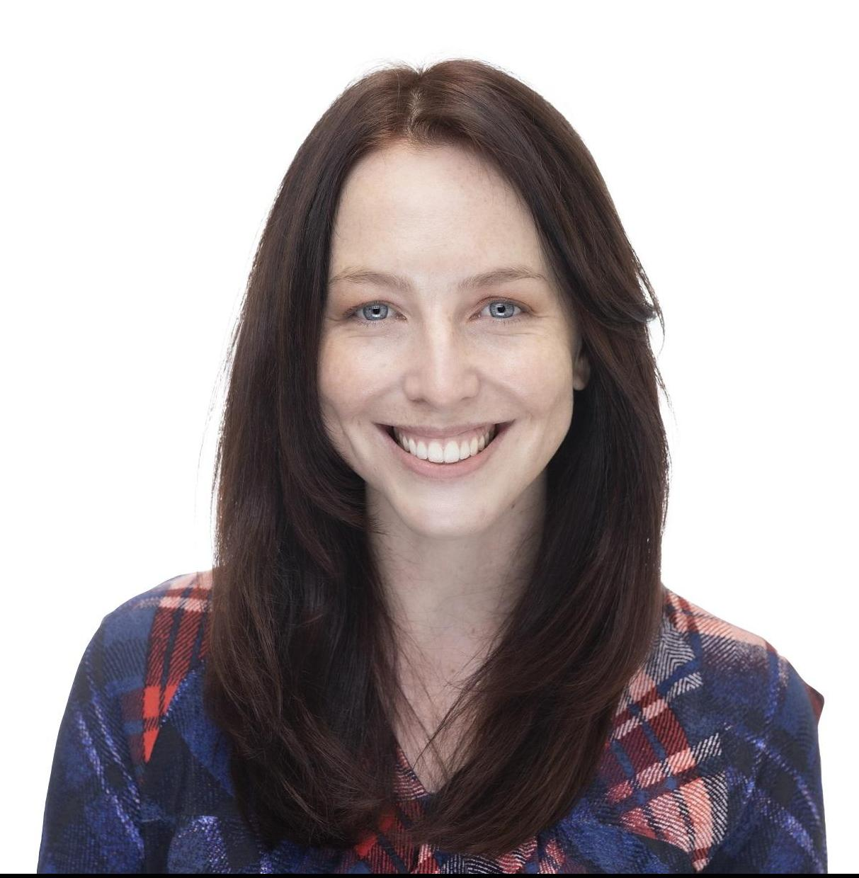
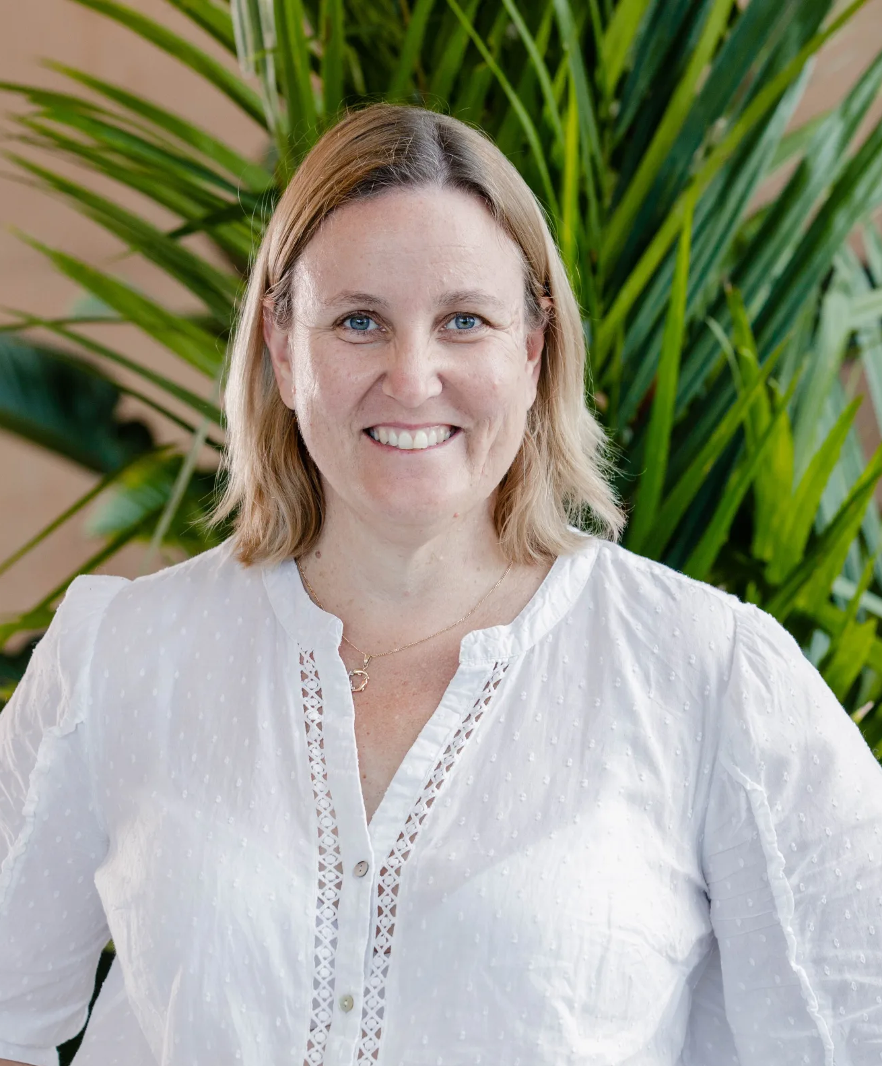
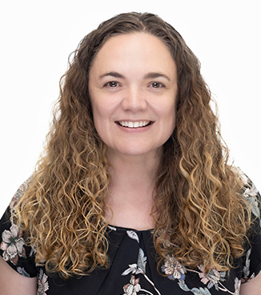
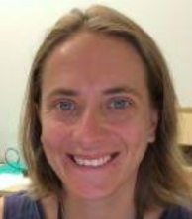
Research team
Notes:
Include logos
Add Associate investigators

Slide 10




The broader team…
8 lived experience advisors
11 co-designers
6+ representatives from partner organisations
20+ participants

Slide 11
Project overview How it started?
Sarah Wallace

Slide 12
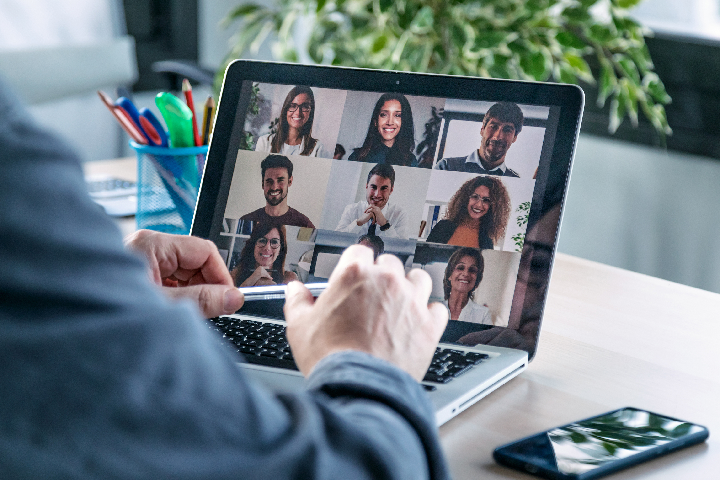
Challenges with web access
The web is used to access many services.
Access to information and services on the Internet is a human right.
People living with a communication disability can find it harder to use the web.
Notes:
Essential services like banking, heath and government services, and social connection.
Example of health services: myGov, medicare, HotDoc

Slide 13
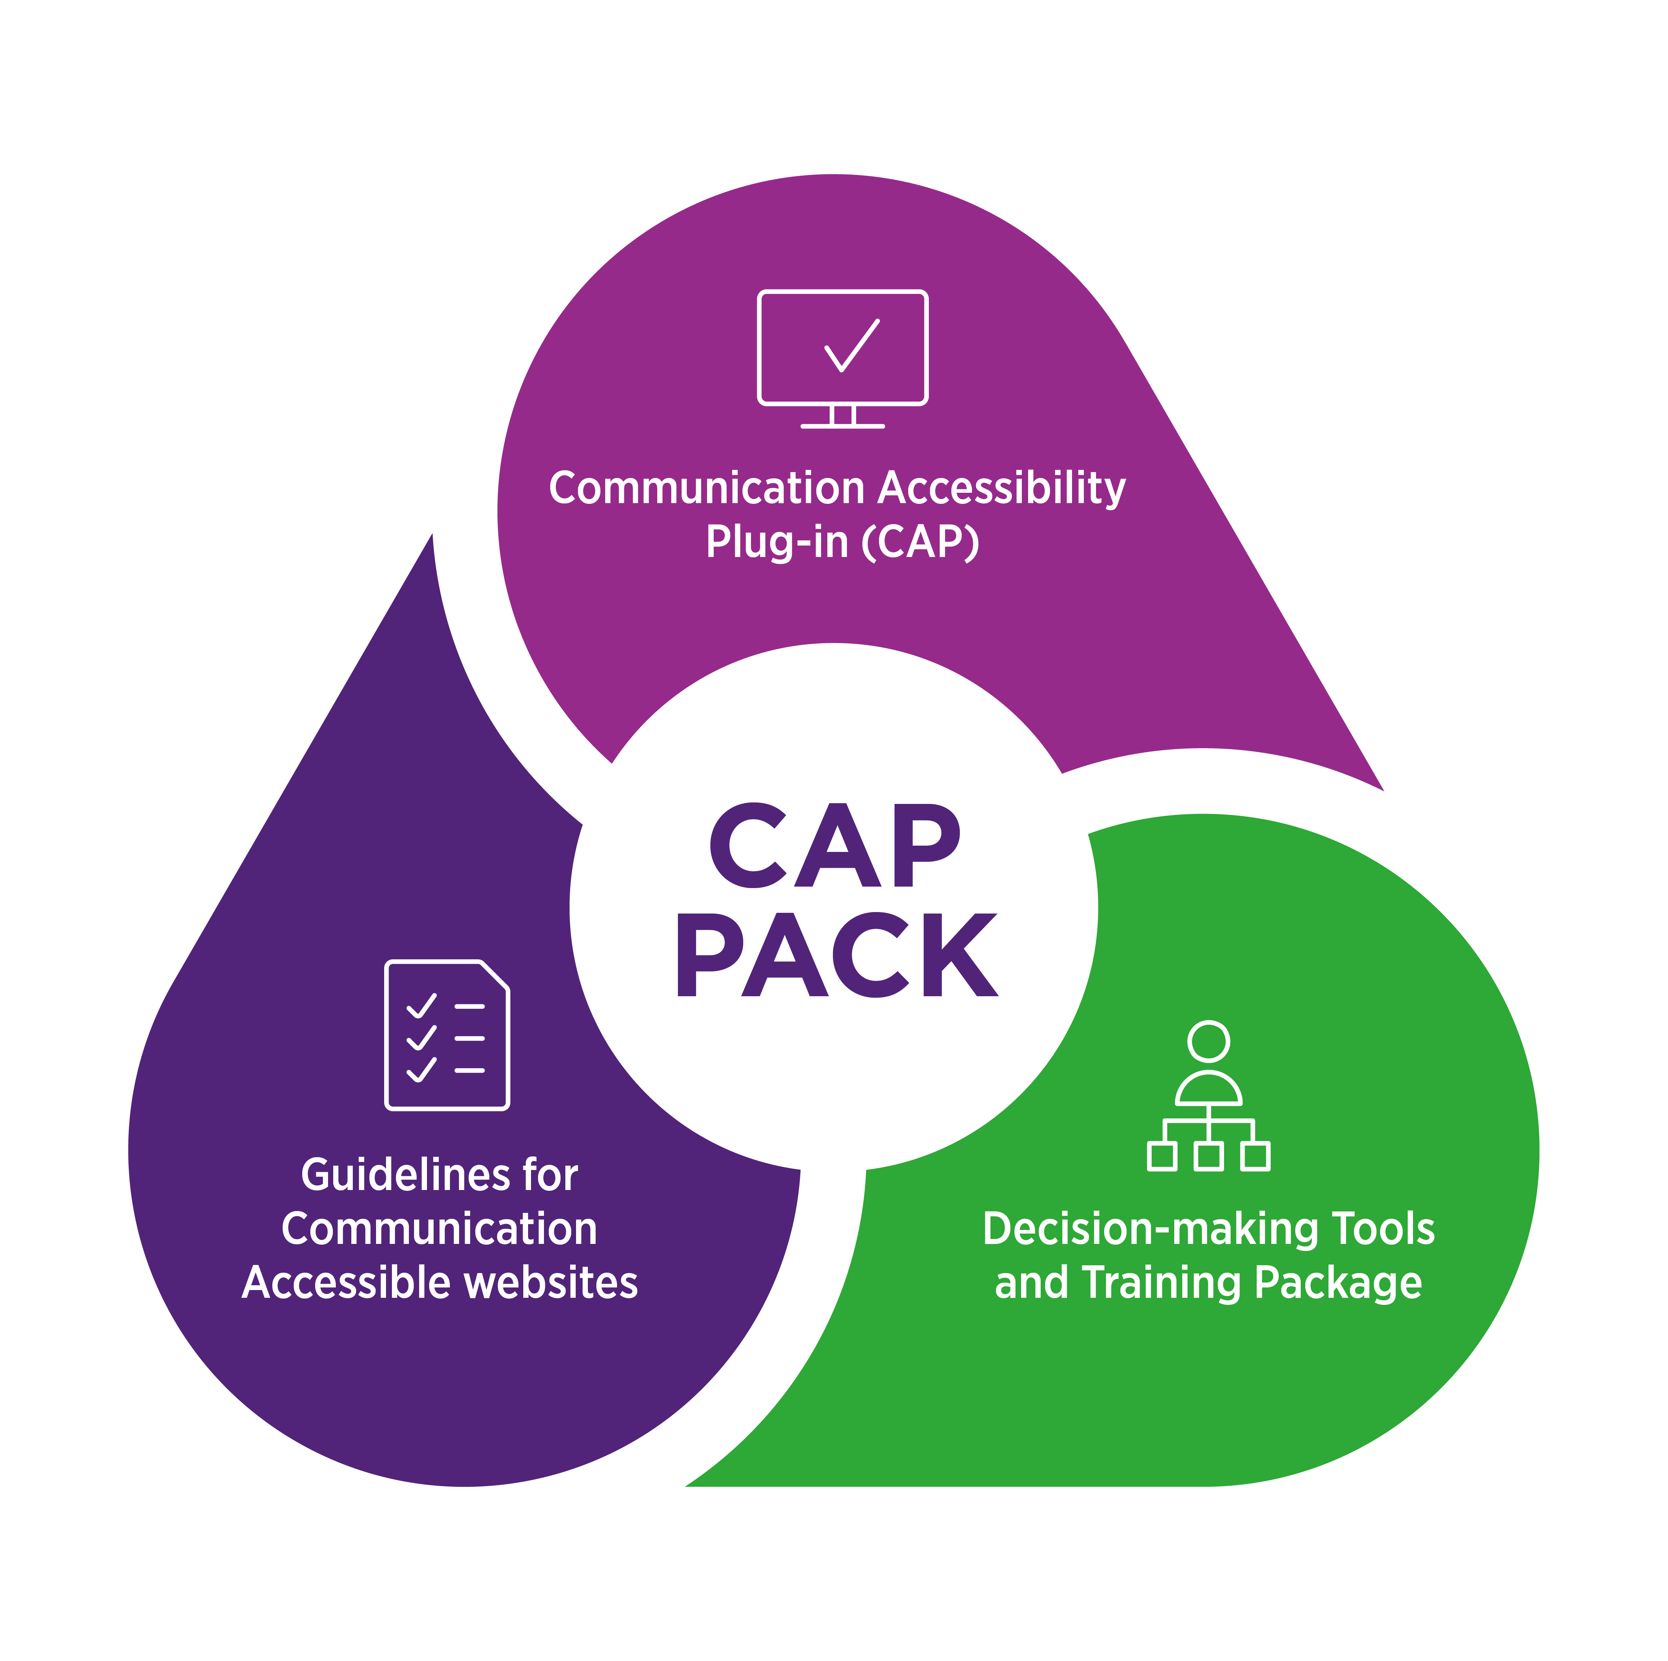


Project aims

Slide 14
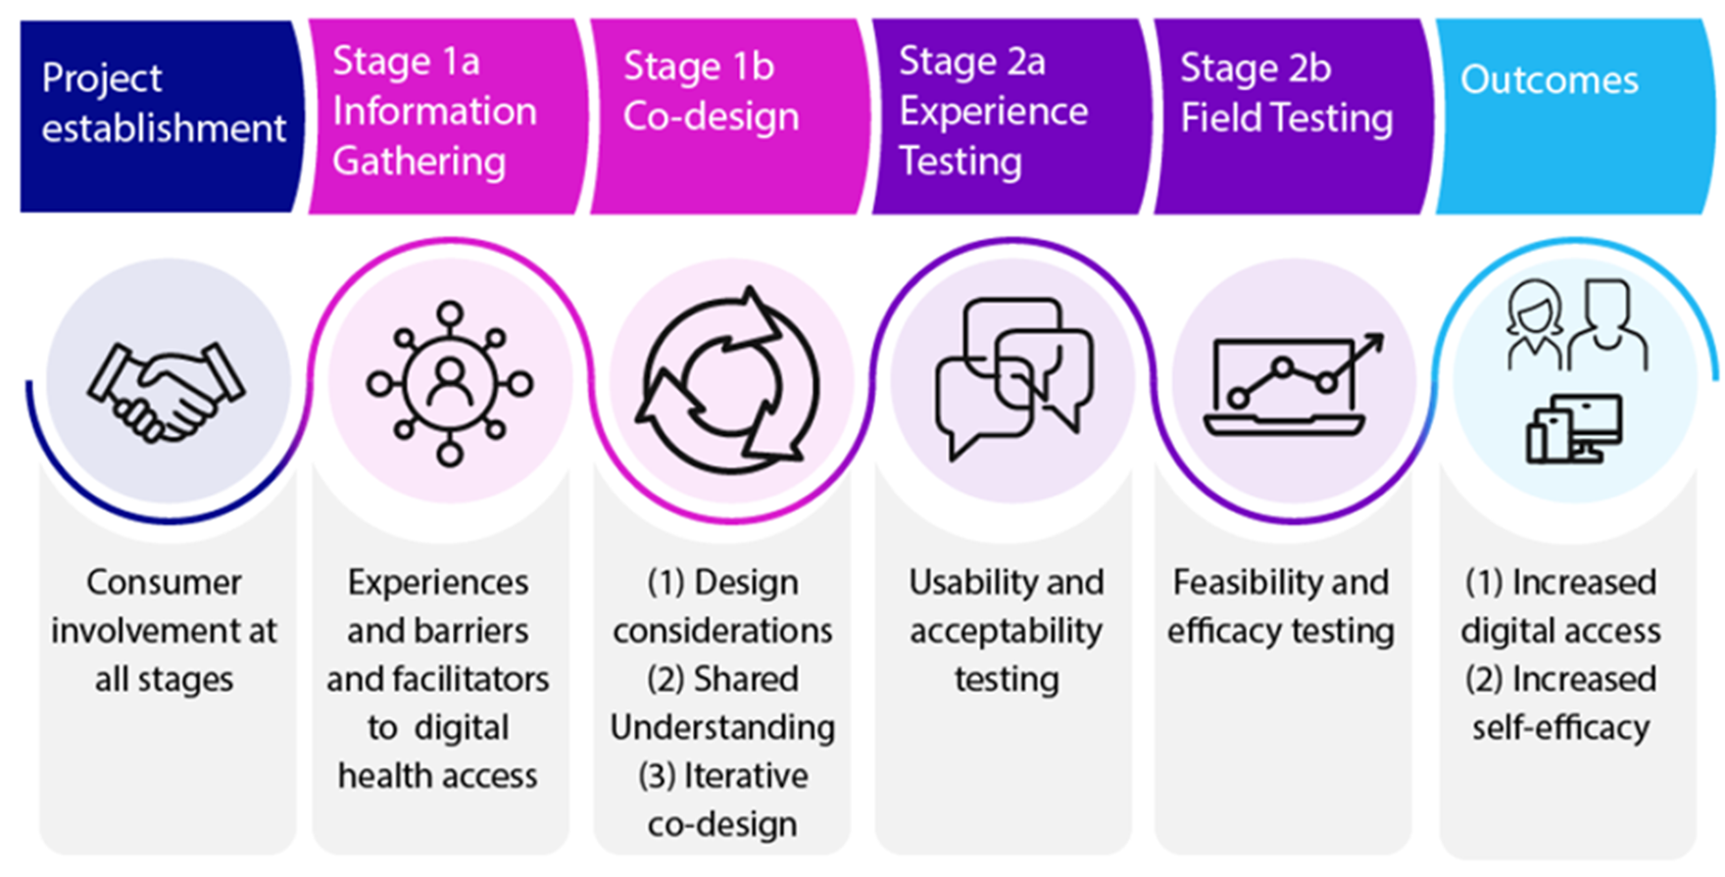

Slide 15
Experience gathering and priorities for improvement
Jen Lee

Slide 16
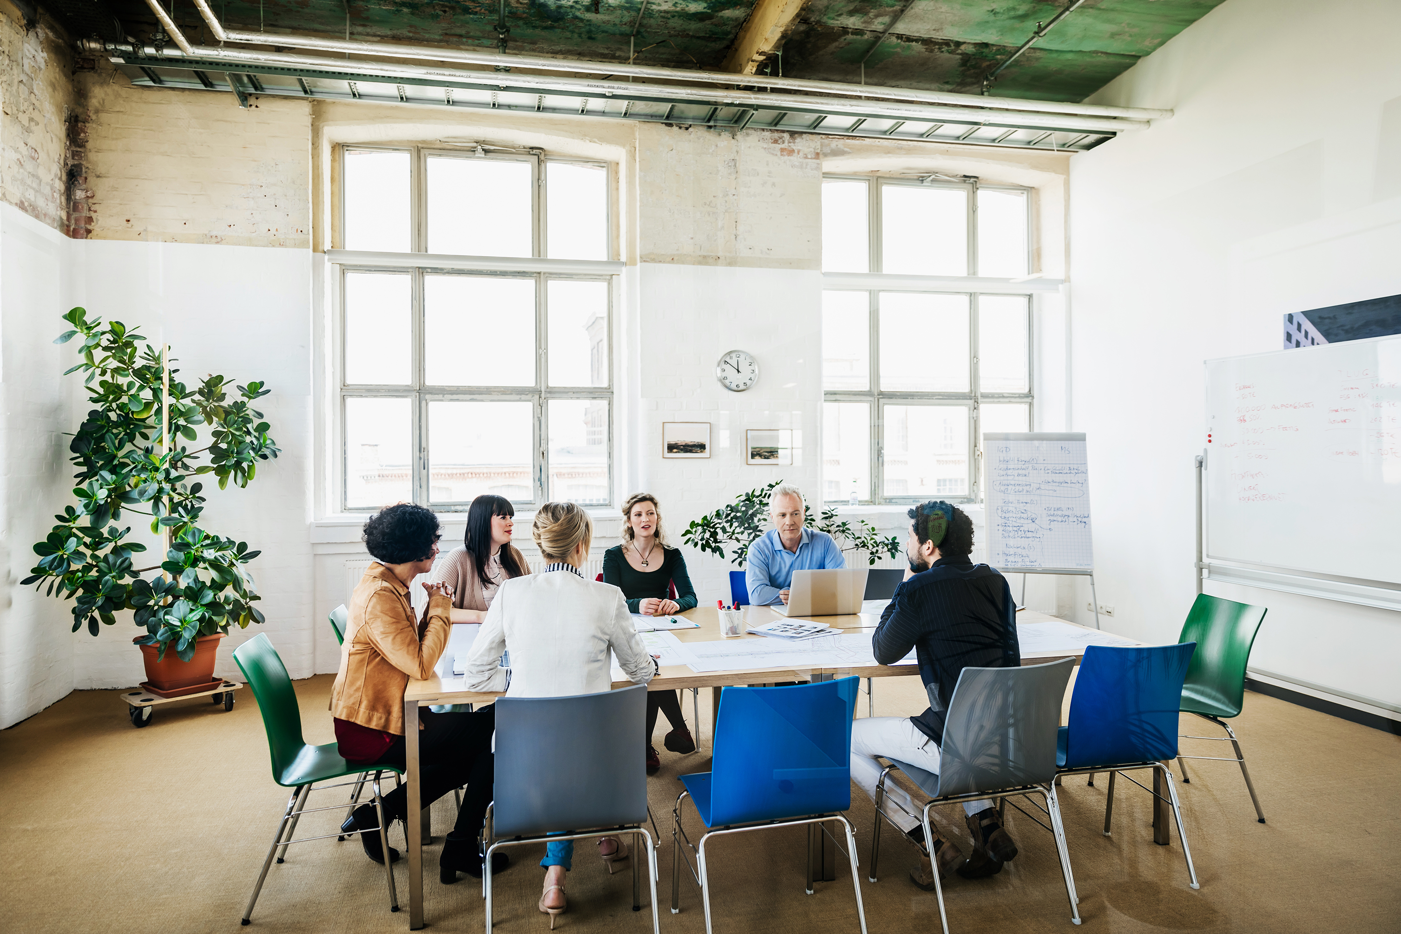
Stage 1a: Experience gathering
Aims:
To understand people with aphasia’s experiences with accessing healthcare, information, and support online
To understand family member’s and health professional’s experiences with providing support
To identify priorities for improving web accessibility for people with aphasia

Slide 17
Stage 1a: Experience Gathering
We completed eight (8) focus groups with:
Nine (9) people living with aphasia
Seven (7) family members
Ten (10) health professionals

Slide 18



Stage 1a: Experience Gathering
We asked participants to:
Share experiences with web use or providing support for web use
Share ideas on what would help with web use
Choose the most important ideas to help with web use

Slide 19
What did we learn?
Six (6) key experiences shared across all focus groups

Slide 20


User-centred design for people with aphasia
“ …everyone with aphasia is different and having flexibility to do things in different ways, I think is an important factor in helping people access.” (Josie, Health professional)
Aphasia awareness
Ability to customise feature to suit users

Slide 21

Confidence building through support and practice
“You're usually there with them, and you can show them, “Okay, this is the one that it is,” direct them, and then they sort of learn that pattern in that process.”
(Lucy, Health professional)
Confidence with technology impacts motivation to get back online
Opportunities to practice builds independence

Slide 22

Challenges to online service access
“it's a big pit of things and you just don't know where to start.” (Anne, Family member)
Filling out forms
Password management
Family members need help for finding information and support online

Slide 23

Searching is hard when you can’t find the right words
“… a lot of times, I can’t [write] more than two or three [letters] and I don't know it.” (George, Person with aphasia)
Spelling can be hard
Assistive technology is not always successful

Slide 24


Written information online is overwhelming
“Everything that comes up on the screen on the internet is all related with words and the difficulties are because, ah, firstly recognising words at all, comprehending collections of words into a meaning, and then dealing with them.” (Peter, Family member)
Text-to-speech rate to suit user preferences

Slide 25

Finding new ways to connect
“His life at the moment is, ah, YouTube on TV… he's fascinated when it, um, profiles him and gives him a whole lot of other subjects.” (Anne, Family member)
Social media
YouTube
Research opportunities

Slide 26


Key priorities
People shared ideas for improving access to healthcare, information, and support services online
Family members and significant others
People with aphasia
Health professionals
72 ideas
47 ideas
82 ideas
Notes:
In the focus groups, we also asked people to share ideas on ways to improve accessing healthcare, information, and support services online.
We had a lot of ideas!
In total, our groups with people living with aphasia had 72 ideas. Family members had a total of 47 ideas, and health professionals had a total of 82 ideas.

Slide 27
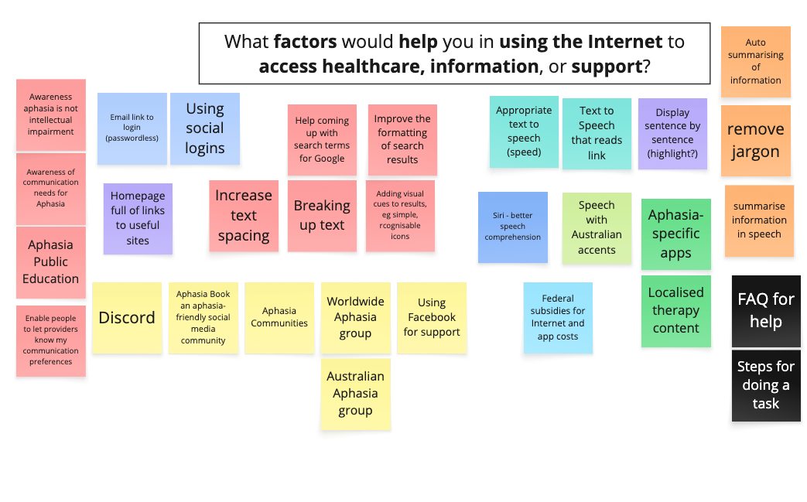

Slide 28





Priorities for improving web use
New technology and tools
Communication-accessible website design
More learning and support resources
Inclusive and tailored technology
Help from a real person
Improve speech recognition
Remove distractions
Guides for finding information and support
Resources for culturally and linguistically diverse users
Easily connect to a real person for help

Slide 29
Co-designing the browser extension
Peter Worthy

Slide 30
Co-design team
5 people with aphasia
3 family members
3 health professionals
2 research partners
6 research team members

Slide 31
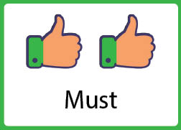
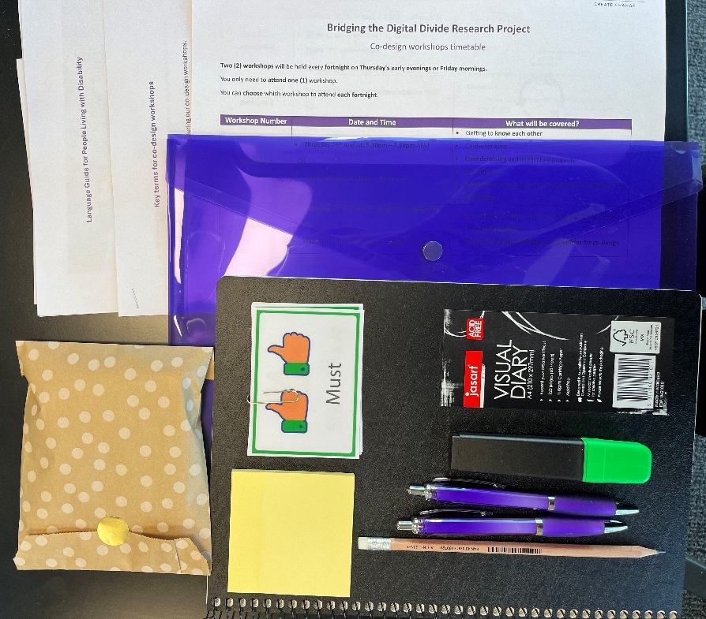
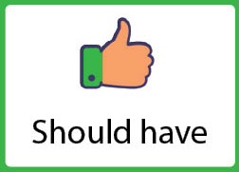
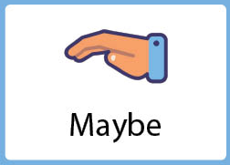
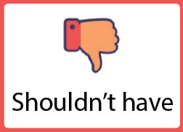
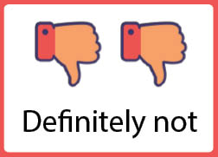
Welcome pack

Slide 32







Co-design activities
Priorities
Possible?
Mock-ups
Review
Aims
Existing Tech
Focus Group Outcomes
Challenges
Magic Machines
Review
Notes:
Magic machines activity

Slide 33
Co-design activities
Everyday challenges using the web
Notes:
Magic machines activity

Slide 34
Co-design activities
Magic machines to help
Notes:
Magic machines activity

Slide 35
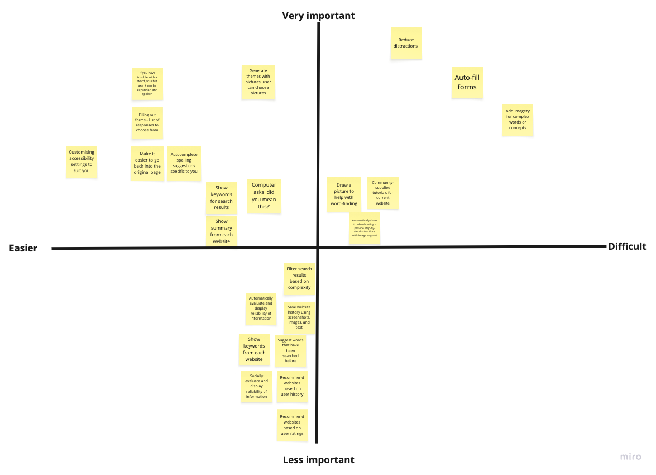
Ranking design features
Co-design activities
What is possible to build?

Slide 36
Ranking design features
Co-design activities
What functions are important to people and easy to build

Slide 37

Mock-ups are used in design to visualise what the final product will look like before we build it.

Slide 38
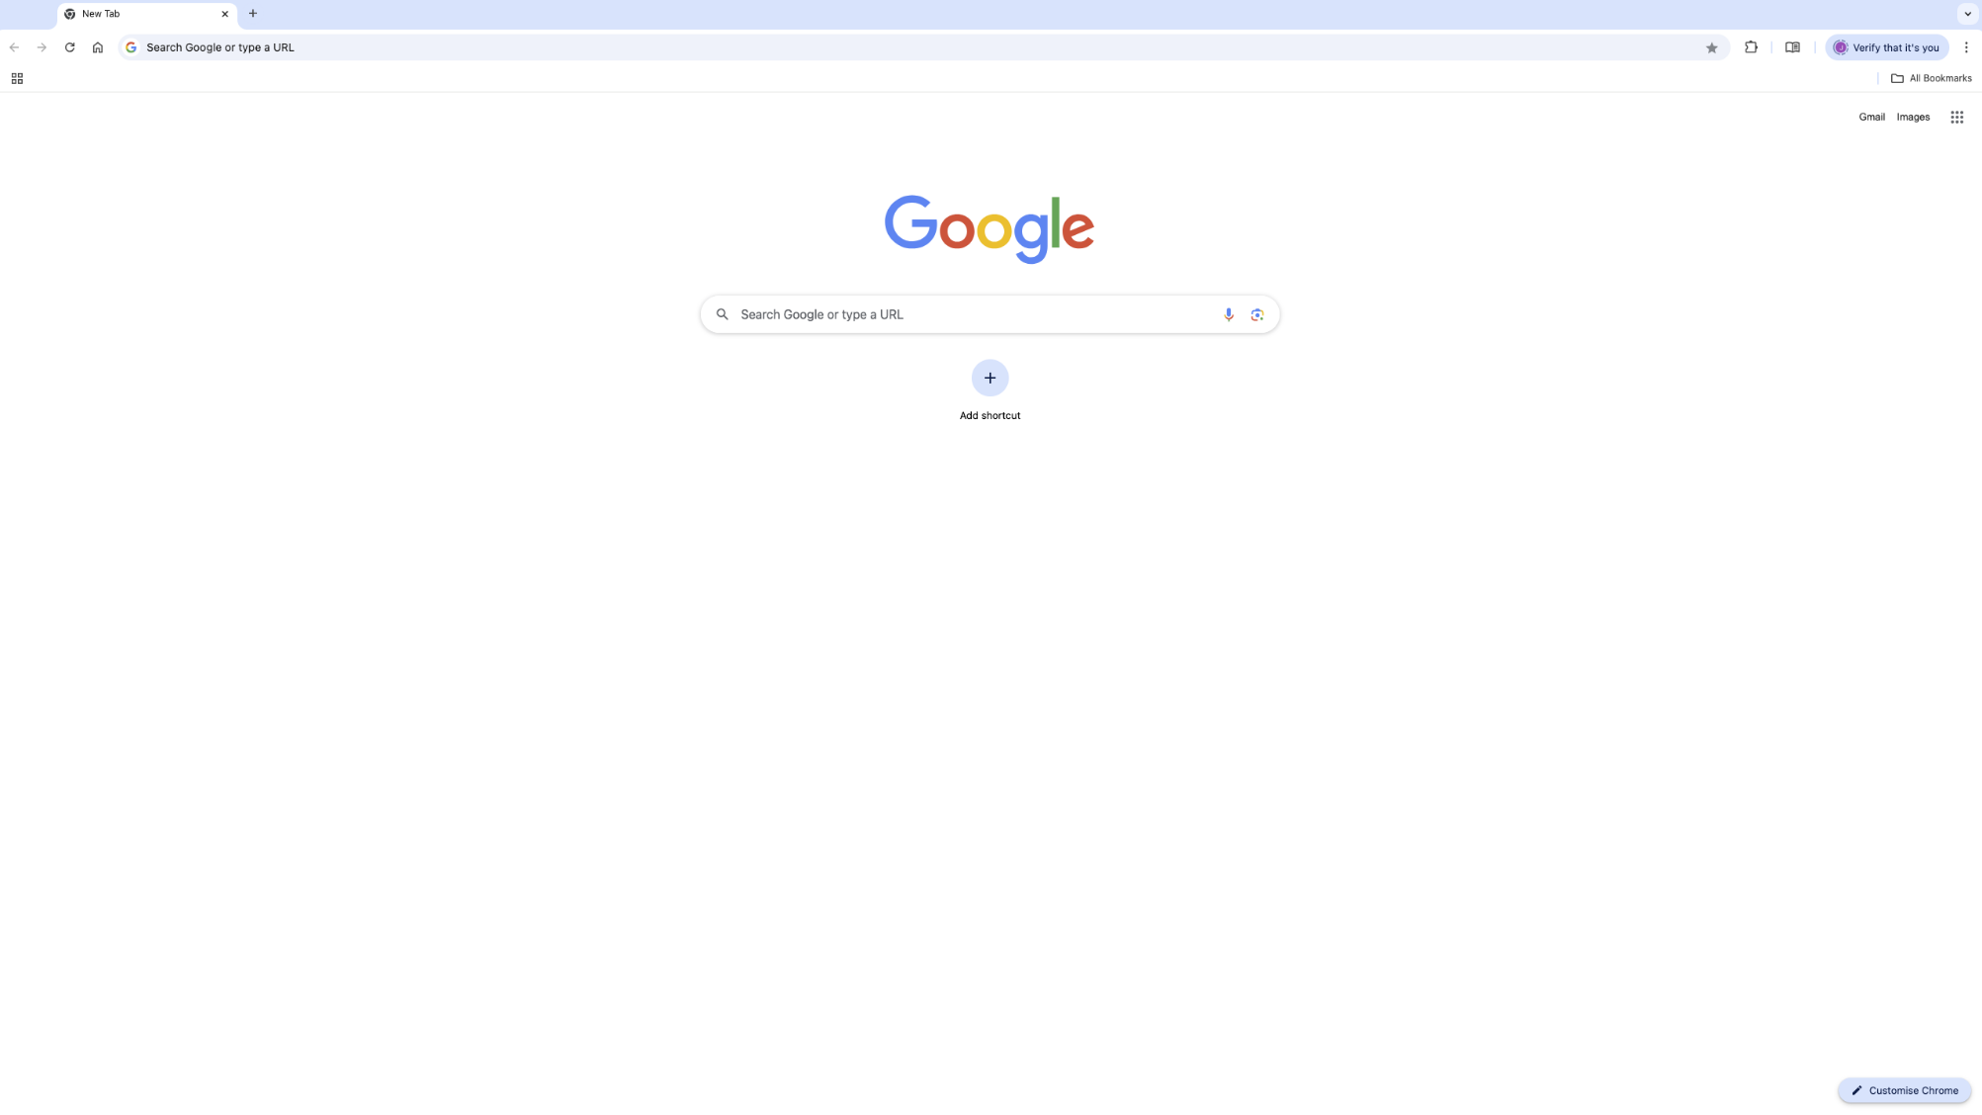
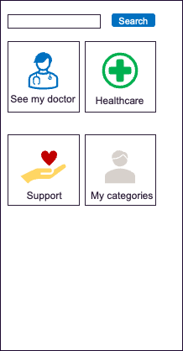

Generate themes with pictures

Slide 39






Search
Healthcare
Dentist
Physiotherapist
Psychologist
Speech pathologist
More…
Back
Home

Slide 40
S
Speech pathologist
Search
Here are the top 5 searches for speech pathologist
1. Speech Pathology Australia
2. Active Speech Pathology
3.
4.
5.
Related searches
speech pathologist near me
speech pathologist adult
speech pathologist cost
More…
Back
Home

Slide 41
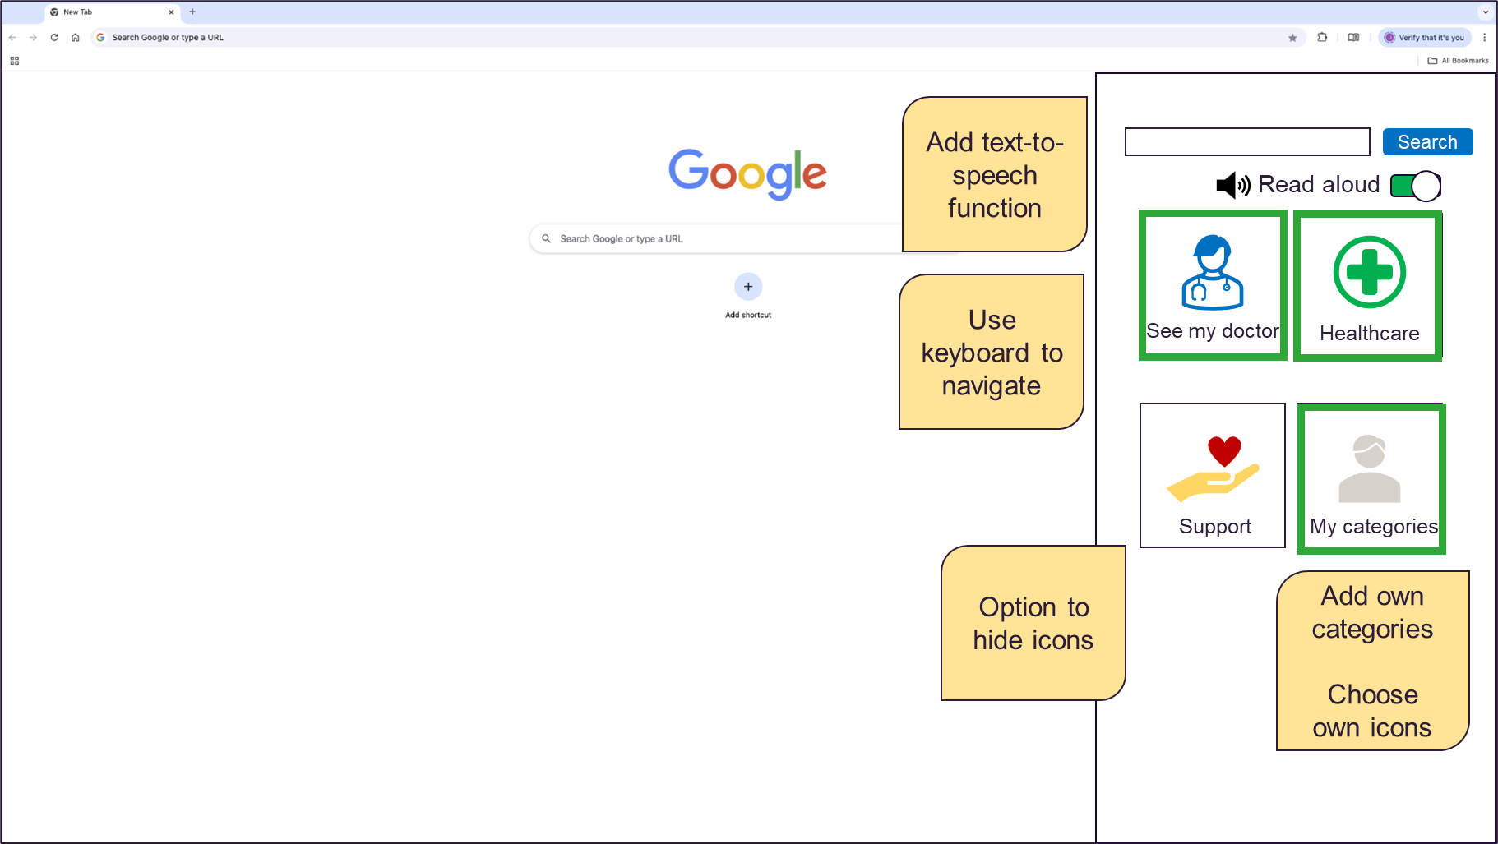

Example of design mock-up
I need to use the keyboard to move between buttons

Slide 42

Key priorities from Co-design
Reduce distractions
Help with reading and understanding information
Help with word finding when searching
Allow the user to customise settings

Slide 43
Developing the extension
1 Plan
2 Design
3 Develop
4 Test
5 Feedback
After co-design we developed the extension.
We used a process called Agile that has sprints.
It took 18 weeks.
Sprint
A sprint is a cycle for completing one feature
Notes:
Development period between Feb and June (~ 9 sprints)
Testing internally but also sought feedback from our consumer advisors who have aphasia
Explain that agile is a software development approach

Slide 44
Introducing CommuniKey
Kim Barron
Notes:
Give Kim control of slides

Slide 45


About CommuniKey
A browser extension is software that adds functions to your browser
Communikey stands for communication key
A browser extension that can help people with communication disability unlock the web
Over 1200 hours of consumer involvement co-designing, developing, and testing CommuniKey
“Unlock the web”

Slide 46
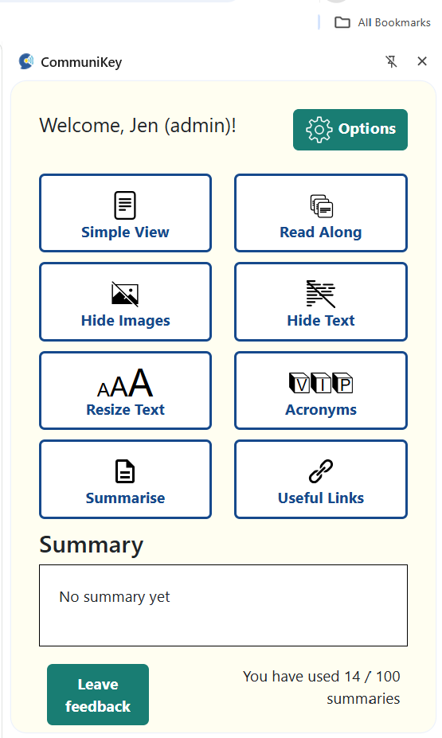
About CommuniKey
Communikey has eight (8) main features
These can help with reading and understanding information online
Options help user set their preferences
Notes:
Include screen shot of side panel

Slide 47
Demo of CommuniKey
Phill Jamieson and Ryan Deslandes
Notes:
Add time onto slide

Slide 48
Have a go!
We have set up some laptops for you to try it out yourself
For online attendees, please join a break-out room.

Slide 49
Usability Testing
Ryan Deslandes
Notes:
To improve it

Slide 50
How easy the browser extension is to use?
How can we make it easier to use?

Slide 51

Testing sessions
Six (6) usability testing sessions
Mixed groups
Eight (8) people with aphasia Three (3) new
Five (5) family members
Two (2) new
Six (6) health professionals
Three (3) new

Slide 52
Testing sessions
Participants completed tasks together step-by-step.
Participants were not given instructions. This allows us to see how intuitive it is to use the browser extension.
Participants rated usability at each step.
Notes:
Participants are not given instructions

Slide 53
Tasks
Customise text-to-speech settings
View the article using Read Along mode
Read the page using Simple view mode
Customise summary settings
Summarise webpage
Change text size
Hide images
Hide text
Find out what acronyms means
Go to the ”Help page” using the side panel

Slide 54



An example of usability testing
1. Click Read Along button
2. Click Proceed button
3. Click Play button
4. Click 'x' button
Task: Open article with Read Along mode and listen using text-to-speech

Slide 55
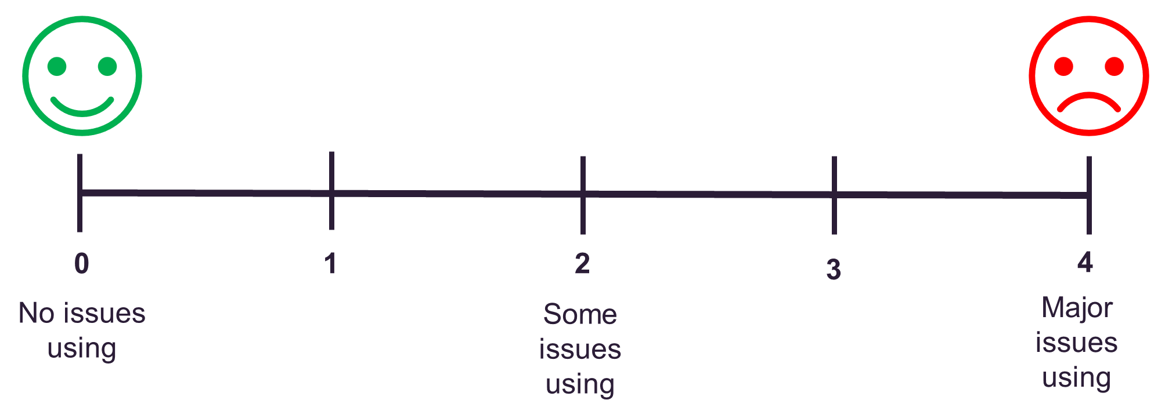
Usability rating scale
Notes:
0 = I don't agree that this is a usability problem at all
1 = Cosmetic problem only: need not be fixed unless extra time is available on project
2 = Minor usability problem: fixing this should be given low priority
3 = Major usability problem: important to fix, so should be given high priority
4 = Usability catastrophe: imperative to fix this before product can be released

Slide 56
Positive feedback
Summarise is helpful
Customisable text-to-speech options
Simple View good for removing distractions
Word highlighting in Read Along
Acronyms will be useful for understanding

Slide 57
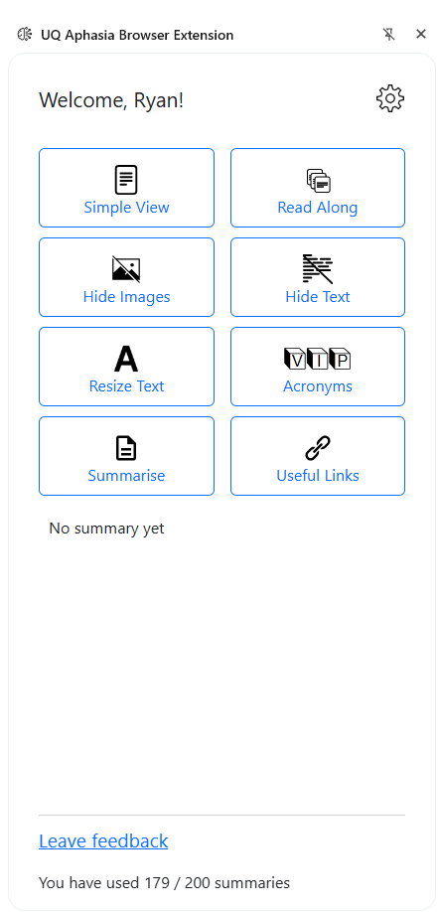
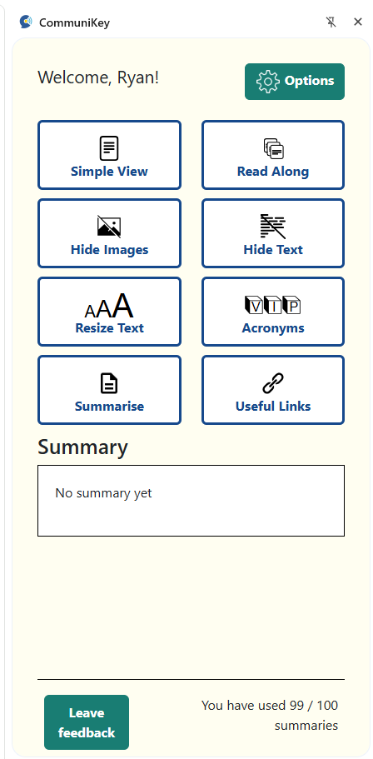
Usability problem #1
Before
After
“I don't think I'd have known to go to the cog “
The cog… the drawing up above ... options

Slide 58
Usability problem #2
“How do you get out of settings though?”
“Could it not have just another cross like another x is that possible?

Slide 59
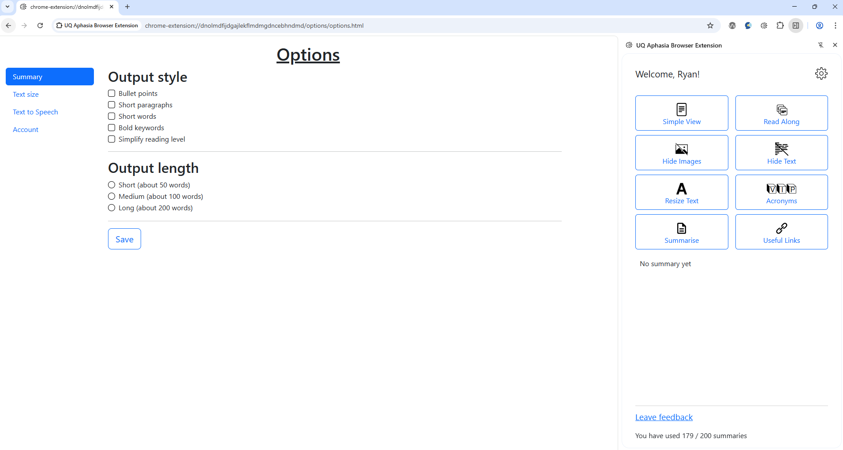
Before

Slide 60
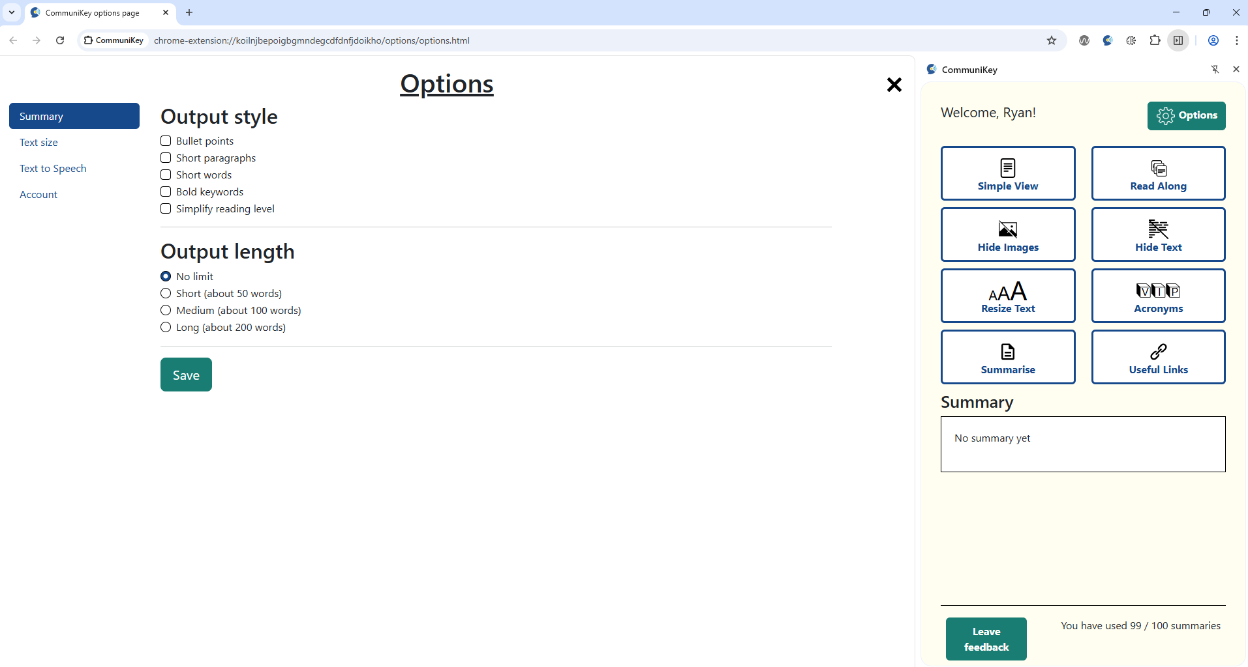
After

Slide 61
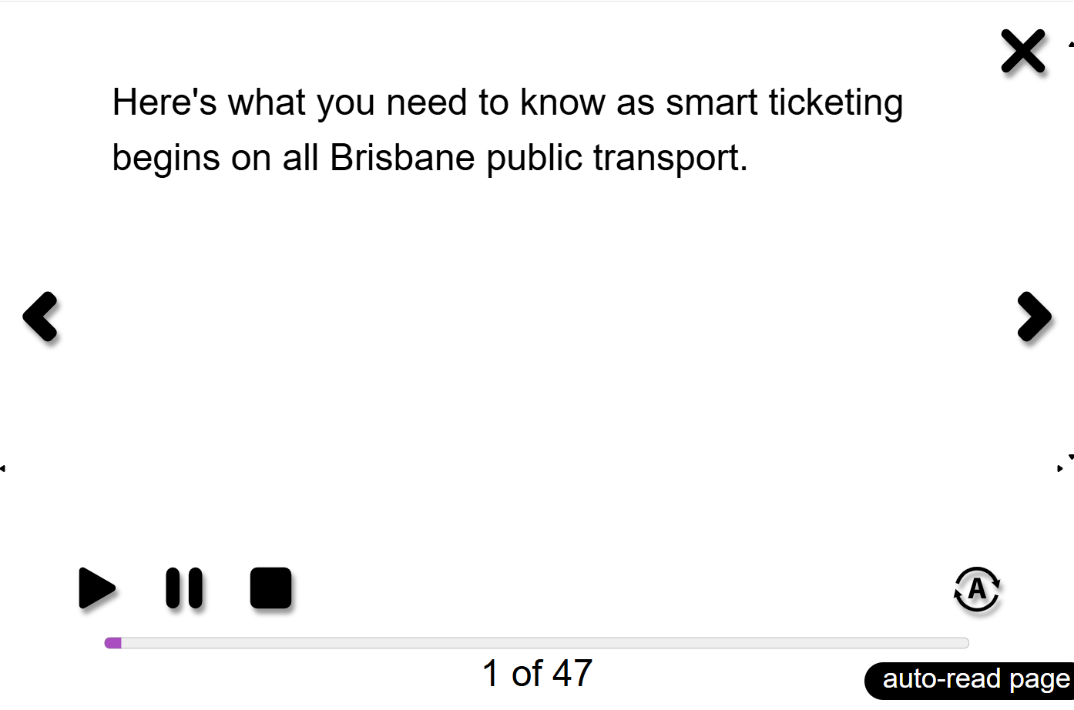
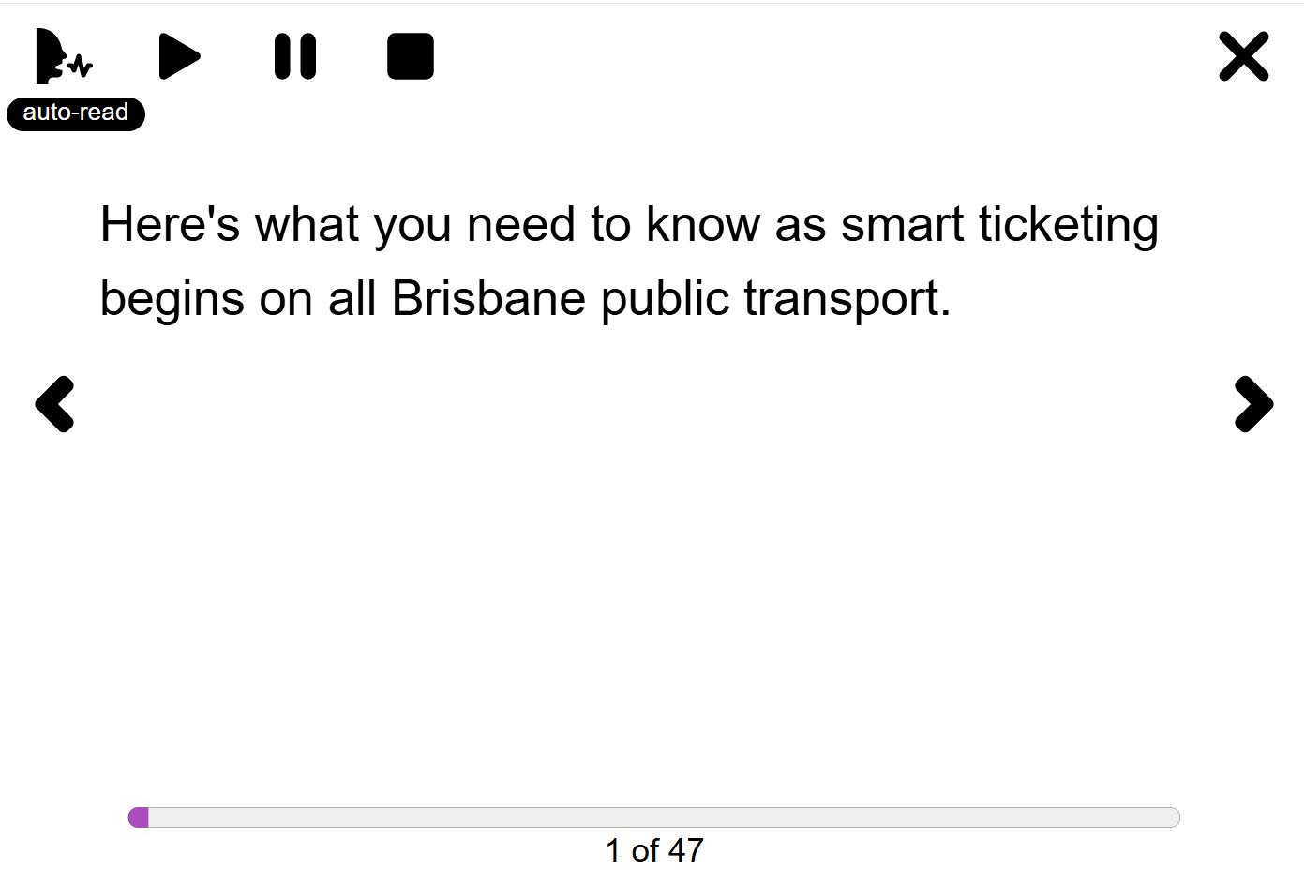
Usability problem #3
After
Before
“The head no good”
“I don't like the person with the head, it confuses me.”
“The icon maybe in my head doesn’t go auto read”
Notes:
Auto play as well
“Not sure what the name "auto read" means.”
“I don't like the person with the head, it confuses me.”
“The icon maybe doesn’t in my head go auto read”
“The icon in my head doesn’t go auto read”

Slide 62
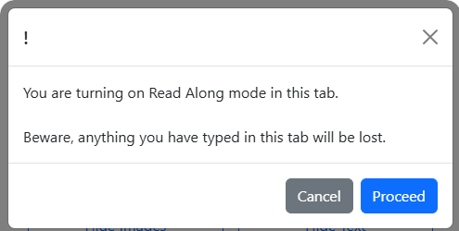

Usability problem #4
Before
“I don’t actually understand what that means”
“You showed it to me once, but kind of like I had to keep pressing it if it went back again, Maybe it doesn't need to happen again.”
After
Notes:
Removed “It opened another box which I had to read and made it more complicated.”
Added “I don’t understand what this means”

Slide 63
Field testing
Sarah Wallace

Slide 64
What is a field test?
A field test is testing a new software in the real world.

Slide 65



Field testing
17 participants recruited, including 8 new participants
Test CommuniKey on their computer for 2 weeks
Complete surveys about self-efficacy and digital health literacy before and after using CommuniKey
Attend a focus group to share experiences

Slide 66




Preliminary results
8 participants completed
1303 interactions
121 summaries generated
Most used feature: Summarise
Notes:
Interactions ranged from 5 - 361

Slide 67
Some feedback
Easy to use!
Some participants only used 1 or 2 features
Wanted it available on their tablet or smartphone – more convenient
Participants didn’t use the training manual but considered training very important
Participants wanted a longer field test period

Slide 68
Next steps for CommuniKey
Sarah Wallace

Slide 69
Accessibility audit
Centre for Accessibility Australia will provide support to check that CommuniKey meets international accessibility standards.
Audit in progress.

Slide 70

When will this be available?
Soon!
We are talking to UniQuest about IP and how CommuniKey can be transferred to the "real world".
We need to think about a funding model to support the use of AI Tools.

Slide 71

Future research
Application submitted to the auDA Community Grant program.
The Community Grant Program aims to enhance the utility of the internet for the benefit of the Australian community.
Supports digital innovation and digital inclusion – including, for people with disability.

Slide 72
Questions or comments?

Slide 73

Thank you!
Please join us for afternoon tea

