Slide 1
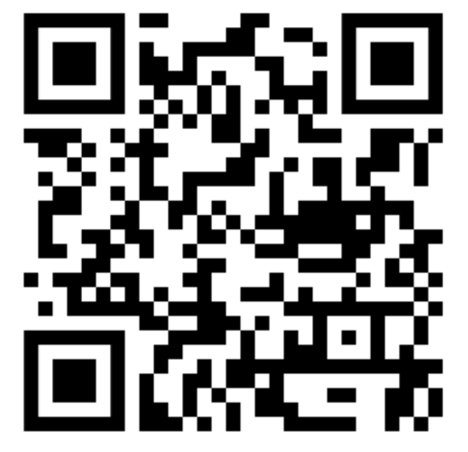
A free online repository of resources to bridge the evidence-practice gap and aid the selection and implementation of evidence-based aphasia therapies: the Aphasia Therapy Finder (ATF)
www.aphasiatherapyfinder.com

